Slide 1
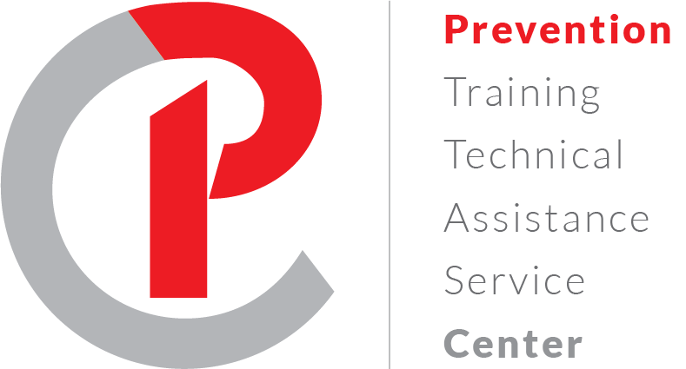
Certified Prevention Specialist Application & Exam Preparation Overview
2025
Notes:
The Prevention Training and Technical Assistance Service Center was funded by the CT Department of Mental Health and Addiction Services in 2015 with the goal of establishing a robust, well-informed robust prevention workforce in Connecticut. The PTTASC supports prevention workers in earning their Certified Prevention Specialist credential as one strategy in prevention workforce development. Preventiontrainingcenter.org

Slide 2
Early definition of prevention
“The active, assertive process of creating conditions and/or fostering personal attributes that promote the well-being of people.”
William Lofquist, Discovering the Meaning of Prevention, 1983

Slide 3
Evolution of Prevention Prevention targets personal attributes and conditions/environment
Teach information about substances (ATOD)
Harms associated with use
Legal consequences
Teach information and skills
Decision making, peer resistance,
Stress management
Teacher information
Expand school prevention efforts
Go beyond curriculum to include school policy, peer led prevention, student assistance programs (interventions)
Engage community partners in prevention efforts
Engage multiple community organizations and volunteers to share ideas and work
Implement evidence-based prevention strategies ( reduce risk factors)
Add focus on environments using public policy & environmental strategies
Continue community-wide prevention. Incorporate data & evidence-based strategies (Strategic Prevention Framework)
Coalition members share data, expertise, resources and ownership of prevention
Use data to identify priority substances and risk/protective factors
Select evidence- based prevention strategies to target RF/PF

Slide 4
Institute of Medicine Continuum of Care of Behavioral Health
Stages of Use
No Use ---- Experimentation
---Social/Reg Use--- High Risk/Problem Use--
-- Addiction---------Recovery

Slide 5
Prevention 101
What is Prevention?
The term "prevention" is typically used to represent activities to stop or reduce an action or behavior. It also represents activities that promote positive attitudes, actions or behaviors while reducing risk.
Research has found that successful prevention efforts must reduce risk factors and promote protective factors to ensure the well-being of children and families.
Protective factors are conditions in families and communities that increase the health and well-being of children and families.
Risk factors are conditions in families and communities that increase the likelihood of negative outcomes.
PF can mitigate against RF.

Slide 6
Rationale for Prevention Certification
Prevention Specialist:
“a certification for your career and your community”
Prevention as a profession:
Specific set of knowledge and skills necessary to do effective prevention work
Research backed work
Data driven
Evidence based strategies
Code of ethics guides prevention work
Don’t get stuck in what doesn’t work
Place of hope & growth for individuals, families & communities

Slide 7
Certified Prevention Specialist
” Prevention Specialist: “a certification for your career and your community
Internationally approved certification, adopted in 1994
50+ US states, territories, and countries offer reciprocal PS credential
Requires professionals to demonstrate competency through work experience, education, supervision, and the passing of a rigorous exam
Check the International Certification and Reciprocity Consortium (IC&RC) for more information

Slide 8
Why become a CPS? Benefits of CPS to the Community
Ensures public safety and well-being through quality programs and a code of ethical conduct that protects consumers of services
Demonstrates thorough understanding of prevention and latest evidence-based practices
Enhances public accountability by employing staff who demonstrate proficiency with competency-based standards.
Ensures ongoing professional development to renew certification and stay current with new and emerging trends and best practices in the field.

Slide 9
Prevention Code of Ethics
All Certified Prevention Specialists sign the Prevention Code of Ethics
Non-discrimination
Competency
Integrity
Nature of Services
Confidentiality
Ethical obligations for community and society

Slide 10
CPS application and exam based on 6 Prevention Performance Domains
6 domains demonstrating variety of prevention competencies including knowledge, skills and behaviors
Developed from IC&RC Prevention Job Task Analysis updated in 2022.
Review the full list of domains and more about Prevention Job Analysis, pages 10-15.

Slide 11
The CT Certification Board (CCB)
Member of the International Certification and Reciprocity Consortium (IC&RC)
Administers CPS application process that certifies applicants to sit for the international exam
Ensures that training/continuing education provided in Connecticut by approved vendors meets established standards
2 applications
Registry application – education, work history, personal demographics
Prevention Specialist application – document work history in each of 6 domains, professional references, training documentation
http://www.ctcertboard.org/

Slide 12
CT Certification Board Staff
Jeff Quamme, CEO, jquamme@ctcertboard.org
Scott Schaefer, Director of Operations, sschaefer@ctcertboard.org

Slide 13
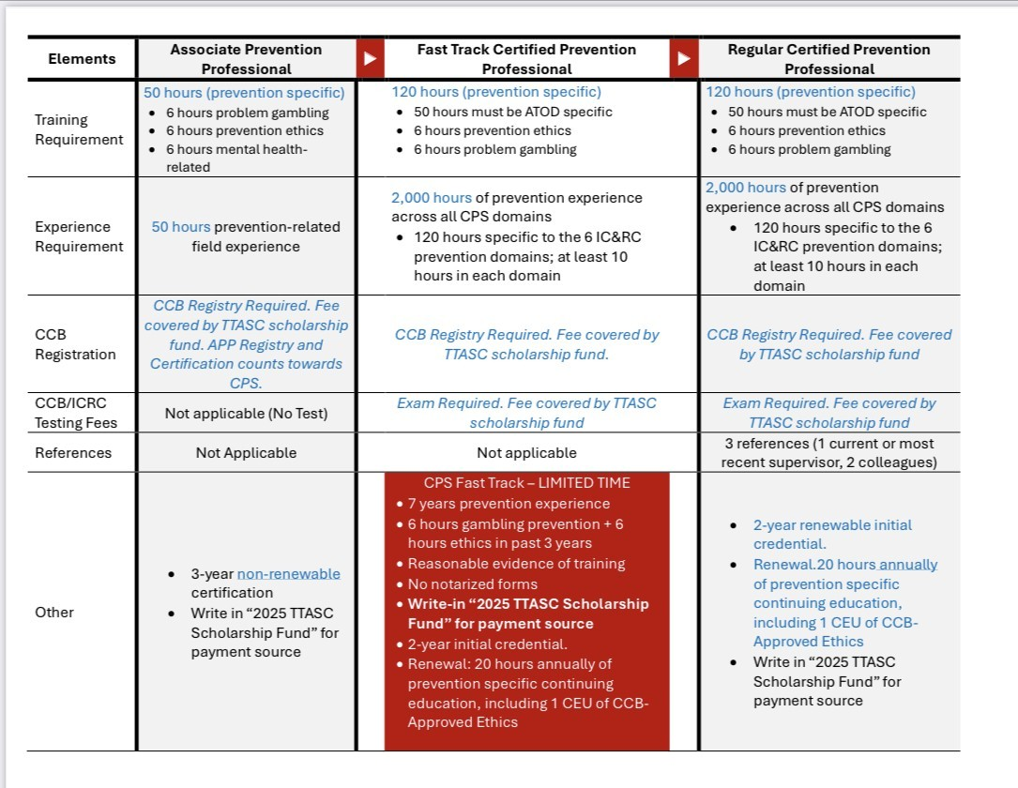

Slide 15
Path to certification
Review IC&RC Prevention Candidate Guide
Complete the CCB Registry and CPS Application
Once approved by CCB, will receive information to register for certification exam
Once register online for exam, have a 90-day window to schedule exam. You select day and time
Take computer-based exam at CCB office
Receive informal notice after exam and formal notice by email.

Slide 16
Traditional Prevention Certification Requirements, Part 1
Supervised Work Experience
2,000 hours of Prevention experience across the domains (1 year full-time) .
Education
120 hours of prevention specific education
50 hours alcohol & drug specific
6 hours of prevention ethics
6 hours of problem gambling
Supervised Practicum
120 hours with a minimum of 10 hours in each of the 6 IC&RC prevention domains
Can use 6 months on your prevention job
Connecticut Certification Board – CPS application with requirements

Slide 17
Traditional Prevention Certification Requirements, part 2
Professional References (checklist with 6 domains)
3 positive professional references –
1 current or most recent supervisor
2 professional colleagues (preferably CCB credentialed)
Prevention Specialist Exam (IC&RC) with passing score - First certification is for 2 years
Annual Renewal Standards
20 hours of prevention specific continuing education

Slide 18
Fast Track CPS
For those with 7+ years prevention work experience…
Same training requirements except do not need complete documentation for all trainings
120 hours prevention training including
50 alcohol/drug prevention
6 prevention ethics of the 100 hours
6 problem gambling of the 100
Exam is required
Fast Track Prevention Specialist Certification

Slide 19
NEW Associate Prevention Professional Credential Application
Entry into the prevention field…
stepping-stone to full certification
Three-year limit. Cannot be renewed
Apply training and work experience used for Associate Certification to full Certification
Requirements
50 hours prevention work experience
50 hours prevention education or training
6 hours prevention ethics
6 hours gambling awareness/prevention
6 hours mental health
No references
No exam required
Associate Prevention Professional Credential Application

Slide 20
Scholarships to cover fees
For a limited time, scholarships are available to cover all the fees for the prevention certification application. First come, first serve until the scholarship fund is used up.
Scholarships can cover fees for the
registry application
prevention certification application
exam
You must write TTASC scholarship in the payment section of the applications.
You must notify TTASC of your request for the scholarship payment so we can keep track of the scholarship fund.
E-mail Jenn Jacobsen, Jacobsen@xsector.com or Lisa Mason, mason@xsector.com with your name, email and which part of the application (registry, traditional CPS, fast-track CPS or associate application) or exam you are seeking the scholarship for.
You must notify Jenn or Lisa if requesting a scholarship for each part so TTASC can track the scholarship funds.
You can also use DMHAS funding to pay certification fees.

Slide 21
What questions or concerns do you have about completing the CPS application?

Slide 22
CPS Exam Prep Worksheets
CPS Specialist Domains Worksheet
Rate the 6 domains on a scale of 1-5 (5 being high) with your confidence level of prevention competencies (knowledge, skills and behaviors)
Feel free to take notes on each domain as we discuss them.
CPS Exam Resource Materials including the six prevention workforce domains
Rhode Island Prevention Certification Guide
IC&RC Prevention Certification Guide
Topics are listed with each domain
Notes:
.

Slide 23
Prevention Specialist Certification Domains Worksheet
Prevention Workforce Competency Domains | Rate knowledge and skills | Knowledge and skills to develop for each domain | Professional development opportunities to explore
Prevention Planning & Evaluation
Prevention Education & Service Delivery
Communication
Community Organization
Public Policy & Environmental Strategies
Professional Growth & Development

Slide 24
Prevention Domains Video Series
Prevention Domain Video Series: What do Prevention Specialists Do?
The video series developed by the New England Prevention Technology Transfer Center (NE PTTC) explains the 6 prevention competency domains as defined by the International Certification and Reciprocity Consortium (IC&RC) Prevention Specialist Job Analysis.

Slide 25
6 Prevention Workforce Domains
Planning and evaluation (25% of exam)
Prevention education and service delivery (15%)
Communication (15%)
Community organizing (15%)
Public policy and environmental change (11%)
Professional growth and development (19%)
Each domain comprises the knowledge and skills prevention specialists need. There is overlap among the domains.
2022 Prevention Specialist Job Analysis provided updated percentages.
Candidate Guide for the IC&RC Prevention Specialist Examination

Slide 26
Performance Domain 1 – Planning and Evaluation (25%) (Prevention as an intentional process – How do we know what to do? How do we know if it works?)
Conduct a comprehensive community needs assessment (Strategic Prevention Framework, Step 1: Assessment)
Data literacy – data collection methods and analysis
Assessing community readiness
Identify existing resources and gaps
Knowledge of risk/protective factors and their identification through local data
Create a prevention strategic plan (SPF, Step 3: Planning)
Knowledge of evidence-based prevention strategies
Select “best fit” prevention strategies that target risk factors and meet local community’s needs
Multiple, ongoing strategies that reinforce each other
Develop an evaluation plan (SPF, Step 5: Evaluation)
Conduct process and outcome evaluation
Adjust program if necessary
Prepare progress reports and share with stakeholders
Share success stories and sustain prevention over time

Slide 27
Performance Domains 1 Planning & Evaluation resources
Resource Materials
CSAP 6 Prevention Strategies
CADCA Environmental Prevention Strategies
Risk and Protective Factors
Stages of Community Readiness
Logic Models
CDC Basic Evaluation Concepts – process and outcome evaluation
Public Health Model of Prevention, Institute of Medicine Continuum of Care, Socio-Ecological Model
Strategic Prevention Framework (3 of 5 steps) – Assessment, Planning and Evaluation
Evidence Based Prevention Strategies
Sustainability Resources

Slide 28
Performance Domain 2 Prevention Education & Service Delivery (15%) (Implementing and conducting prevention activities)
Select and conduct prevention education activities
Provide accurate, relevant and timely content
Select content/curriculum that meets local needs
Teach or train others in prevention content/curriculum
Facilitation and listening skills
Implementation fidelity
Adapt content for diverse audiences with support of diverse stakeholders
Process evaluation to ensure implementation fidelity
Resource Materials
Prevention Ethics Code
CSAP 6 Prevention Strategies
Evidence Based Prevention Programs
Cultural competency resources
SPF, Step 4: Implementation

Slide 29
Performance Domain 3 Communication (15%) (Providing and exchanging information. Individual, group and mass communication. Listening to concerns & hopes.)
Communication
Promote programs, services and activities
Maintain good public relations
Listening, public speaking and facilitation skills
Making information relevant to audiences
Plan and implement community engagement
Coalition meeting facilitation
Report writing
Social marketing campaign planning and implementation
Interpersonal competence
Resource materials
Prevention ethics code
Prevention theory, risk and protective factors
SPF, Step 2: Capacity Building
Social marketing resources
Cultural competency resources
Health literacy resources

Slide 30
Performance Domain 4 Community Organizing (15%) ( Building a prevention system to continue work. Identifying & engaging prevention leaders and volunteers.)
Community Organizing (15%)
Identify community demographics and norms
Assess community readiness & capacity
Understand stages of change
Build relationships with community leaders
Support coalition in mobilizing for community change
Build coalition capacity = resources + readiness
Build community ownership of prevention programs
Cultivate coalition leadership
Sustaining programs beyond grant awards
Resource Materials
Managing complex change
Stages of community readiness
Stages of change, Tri-Ethnic Theory of Change
SPF Step 2: Capacity Building
Cultural competency resources
Sustainability resources

Slide 31
Performance Domain 5 Public Policy and Environmental Change (11%) (Focus on the environment along with the individual and families. Lessons learned from tobacco prevention & research. Helps to sustain change.)
Public Policy and Environmental Change (12%)
Knowledge of public policy development and advocacy work
Preparing & mobilizing coalition/community as change agents
Knowledge of enforcement initiatives
Collaborate with community partners on mutual goals
Media strategies to change community norms and support policy change efforts
Resource Materials
CADCA environmental prevention strategies
Evidence-based prevention strategies
Prevention ethics code
Advocacy guides

Slide 32
Performance Domain 6 Professional Growth & Responsibility (19%) (Ethical code governs work, continued education, self-care, model/mentor for youth, families, communities.)
Professional Growth and Responsibility (15%)
Demonstrate knowledge of current prevention theory and practice
Adhere to legal, professional, and ethical principles
Advocate for heathy and safe communities
Advocate for health promotion across the lifespan
Demonstrate knowledge of current issues of addiction, mental, emotional, & behavioral health
Resource Materials
Prevention ethics code
Prevention advocacy guides
Prevention theory – Social Development Model, Socio-Ecological Model, Stages of Change

Slide 33
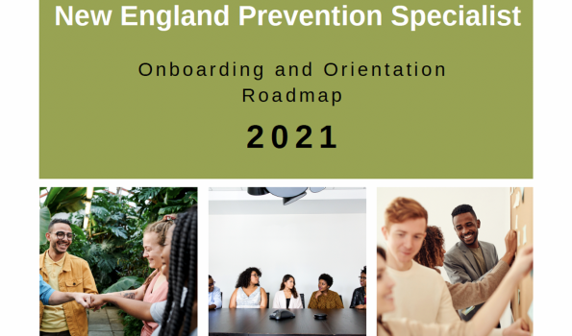
NE PTTC Prevention Specialist Orientation Resources
New England Prevention Specialist Onboarding and Orientation Roadmap 2021 description
New England Prevention Specialist Onboarding and Orientation Road Map 2021 PDF
Notes:
The Prevention Training and Technical Assistance Service Center was funded by the CT Department of Mental Health and Addiction Services in 2015 with the goal of establishing a robust, well-informed robust prevention workforce in Connecticut. The PTTASC supports prevention workers in earning their Certified Prevention Specialist credential as one strategy in prevention workforce development. Preventiontrainingcenter.org

Slide 34
CPS Exam Study Guides
Rhode Island Prevention Specialist Certification: Study Guide for the Certification Exam (updated 2024)
105 pages, set up like a text-book to cover key topics
Flash cards of key terms
Practice test with 55 questions and answers
Practice activities (process vs outcome evaluation; universal, selective or indicated prevention
Exam resource list of additional materials
Candidate Guide for the IC&RC Prevention Specialist Examination
Based on the 2022 Prevention Specialist Job Analysis
Rules, security protocols, grievance process
Description of the six domains
Practice test with 10 questions
IC&RC links to the Rhode Island Guide on their website

Slide 35
Training options
Prevention Training & Technical Assistance Service Center
On-demand trainings with CEUs available in addition to zoom & in-person trainngs
CT Clearinghouse
Governor’s Prevention Partnership
Regional Behavioral Health Action Organizations
Prevention Training Technology Center (national)

Slide 36
Exam Overview
Computer-based exam
3 hours to complete. Most take 2 – 2.5 hours
Quick tutorial before exam. Survey at end.
Neither count towards 3 hr. timeframe.
Scores range from 200-800, with 500 to pass
Exam has 150 question pool
125 count toward your score
25 are test questions that don’t count
Need to successfully answer 78 of 125 to pass

Slide 37
Exam Overview
Multiple choice with 4 answer choices per question
No “multiple multiples” i.e. Both A and C
Questions
Many are fairly easy and answer quickly.
Some take more thinking but could be figured out.
A smaller percentage were really difficult.
Complex questions
Read through 2 or 3 times. Look for key words or at context.
Review choices for “only”, “best”, “always”
You can bookmark question and go back.
Keep in mind: Some are questions are being tested for future use.
Answer all questions
No penalty for wrong answer
Better to guess.

Slide 38
Exam Results and Renewal
All questions must be cited in a valid and reliable source
Percentage of exam questions related to each of 6 domains %
Preliminary results provided immediately after exam completion. Formal letter sent after exam completion.
First certification last 2 years.
Renew for 1, 2, or 3 years.
20 CEUs/year required for each renewal year. Requires 1 CEU of Prevention Ethics every renewal.
Provide CT Certification Board with an email in case you change jobs. Will use for renewal notification.

Slide 39
CPS Exam Study Guides
Rhode Island Prevention Specialist Certification: Study Guide for the Certification Exam (updated 2024)
105 pages, set up like a text-book to cover key topics
Flash cards of key terms
Practice test with 55 questions and answers
Practice activities (process vs outcome evaluation; universal, selective or indicated prevention
Exam resource list of additional materials
Candidate Guide for the IC&RC Prevention Specialist Examination
Based on the 2022 Prevention Specialist Job Analysis
Rules, security protocols, grievance process
Description of the six domains
Practice test with 10 questions
IC&RC links to the Rhode Island Guide on their website

Slide 40
Preparing for the exam
Consider your learning style
Visual learner – reading and writing: note taking, flashcards, diagrams, color coding info
Auditory learner – speaking and hearing: reading aloud, after reading silently, recite a summary, find a study partner or group
Kinesthetic learner – doing or experiencing: short blocks of time, build model physically or in head, move around while studying
Create study checklists
Focus on key content areas, key terms & concepts
Review questions in study guides for how questions can be worded, especially complex one.
From
Studying for Success: Preparing and Passing the IC&RC Prevention Specialists Exam (draft)
Tennessee DMHAS
No longer available online, contact TTASC

Slide 41
What to expect at the exam
Wellness – eat well, sleep well before exam
Bring valid government issued photo ID and Candidate Admissions Letter from CCB
Arrive early
Exam begins with a brief tutorial. Followed by brief survey. Extra time is allotted is for the tutorial and survey
Testing center provides pens and scratch paper

Slide 42
Test taking tips
1. Pace yourself.
2. Read all instructions, each question, and the possible answers very carefully.
3. Look for keywords.
4. Pay attention to answer options such as “all of the above” or “none of the above”.
5. Pay attention to words such as every, all, none, always, and only.
6. Eliminate obviously wrong answers.
7. Do not over‐analyze the questions.
8. If you do not have an answer, skip the question and come back to it later.
9. Make an educated guess if you are uncertain. No penalty for wrong answers!
10. Answer every question.
11. Stay calm and breathe.
From
Studying for Success: Preparing and Passing the IC&RC Prevention Specialists Exam (draft)
Tennessee DMHAS
No longer available online, contact TTASC

Slide 43
What concerns do you have about taking the CPS exam?

Slide 44
Prevention Training and Technical Assistance Service Center
Email TTASC staff with questions about the CPS applications and exam or to schedule a zoom meeting to discuss the application or process.
Contact
Jenn Jacobsen, Jacobsen@xsector.com
Lisa Mason, mason@xsector.com
Notes:
The Prevention Training and Technical Assistance Service Center was funded by the CT Department of Mental Health and Addiction Services in 2015 with the goal of establishing a robust, well-informed robust prevention workforce in Connecticut. TTASC supports prevention workers in earning their Certified Prevention Specialist credential as one strategy in prevention workforce development. Preventiontrainingcenter.org

