Slide 1
Fundamentals of Vaping/Electronic Nicotine Delivery Systems
Insert Organization Name and Logo
Insert Presentation Date
Notes:
Highlighted sections must be customized by presenter

Slide 2
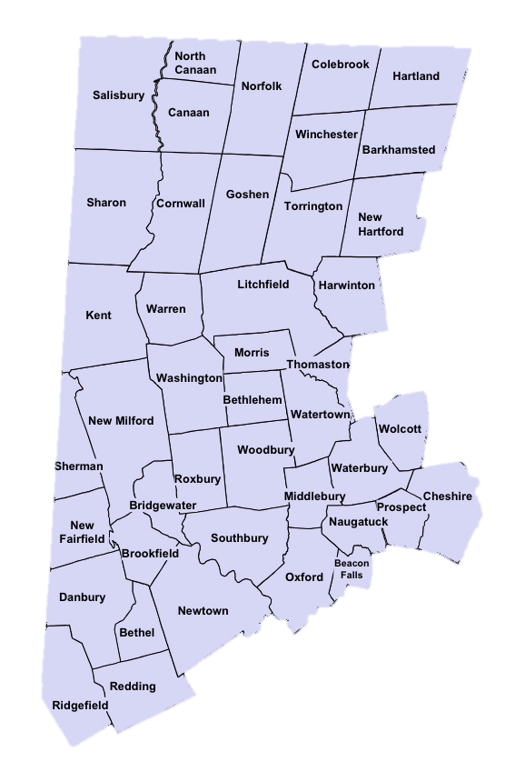
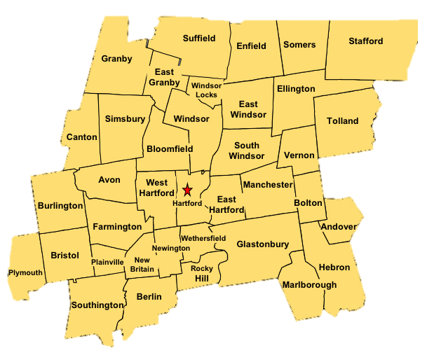
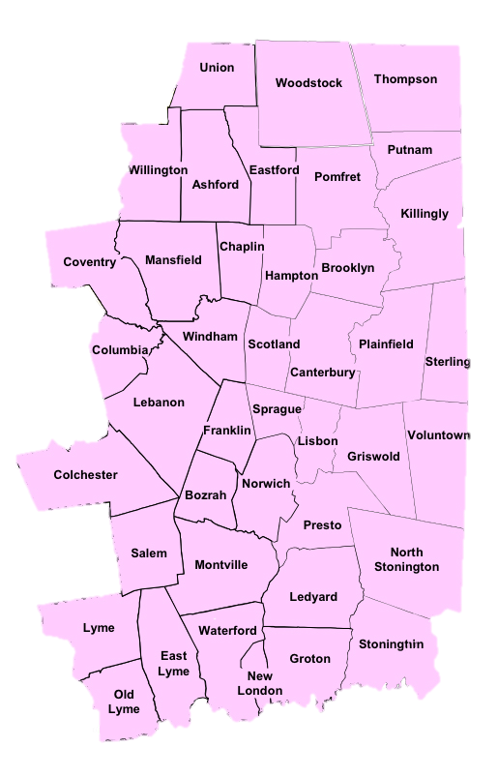
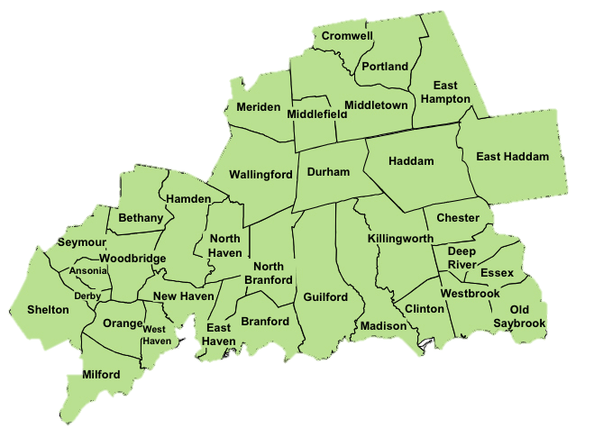
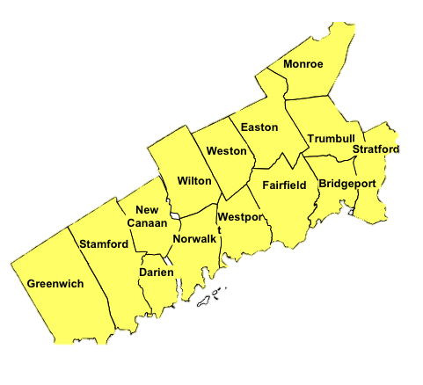
Organization Name
Organization Description
Region Served
Contact Information
Notes:
Highlighted sections must be customized by presenter
This RBHAO map/image is split up into sections that allow you to separate and highlight the region of interest.

Slide 3
Learning Objectives
Identify type of substance
Identify short and long term effects
Use data to understand current use among youth and special populations
Identify risk and protective factors associated with substance
Identify prevention strategies targeting risk and protective factors
Provide additional resources
Notes:
The learning objectives for this presentation as follows:
Familiarize yourself with the law regarding tobacco/vape use
Gain a basic understanding of electronic delivery systems (ENDS)
Identify the short- and long-term health effects associated with vape/END usage
Review vape use survey data to identify usage trends among subgroups or special populations
Identify the risk and protective factors associated with vaping
Review strategies for parents to communicate with their children, schools, and community about vaping prevention.
Provide additional resources for future learning

Slide 4
Agenda
Segment 1: Priority Substance(s)
Segment 2: Prevention Basics
Law & Policy
Drug Facts
Access
Patterns of Use
Effects of Use
Substance Use Prevention
Socio-Ecological Model
Risk & Protective Factors
Strategic Prevention Framework
Segment 3: Evidence Based Practices
Segment 4: Measure and Metrics
Segment 5: What’s Next
Relevant Definitions
Evidence Based Best Practices
Evidence Based Prevention Strategies
SAMHSA Vaping Resources Guide
Next Steps in Implementing Prevention Practices
Notes:
The presentation includes five modules. The modules can be discussed individually. Collectively, all of the modules will provide a strong foundation for understanding the fundamentals about vaping.

Slide 5
Segment 1: Priority Substance(s) Vaping Tobacco and Cannabis
Law and Policy
Drug Facts (e.g., drug class, photos, street names, and cost)
Access
Signs and Symptoms of Use
Patterns of Use (e.g., disparities, include factors such as COVID-19)
Impacts of use/misuse (long and short-term)

Slide 6
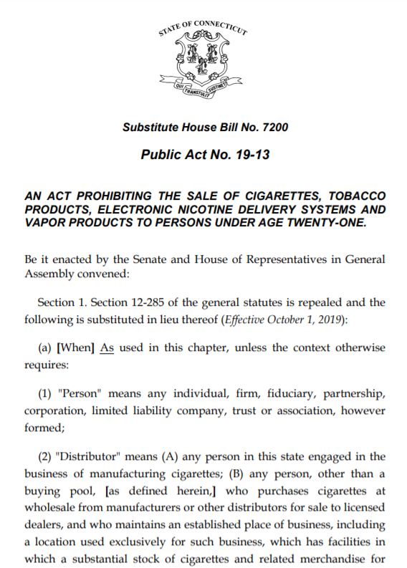
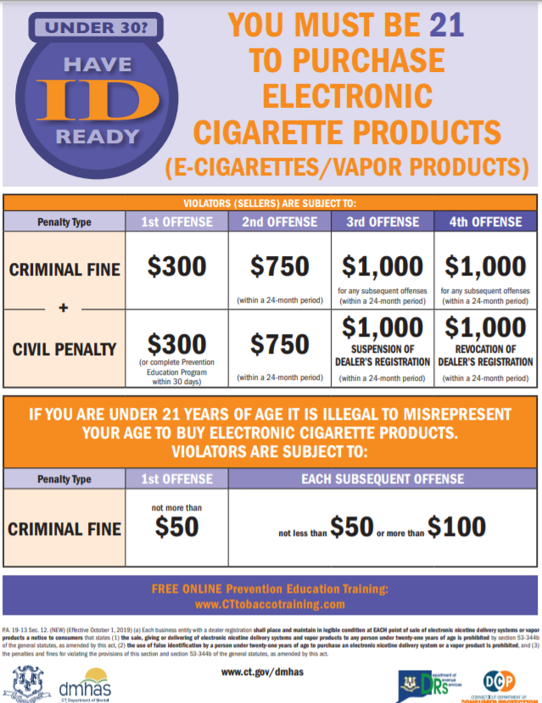
Law and Policy (e-cigs)
Notes:
October 1, 2019 legislation was passed requiring that you must be 21 to purchase vaping products
Those selling vaping products to folks under 21 face penalties including fines and revocation of dealer’s registration

Slide 7
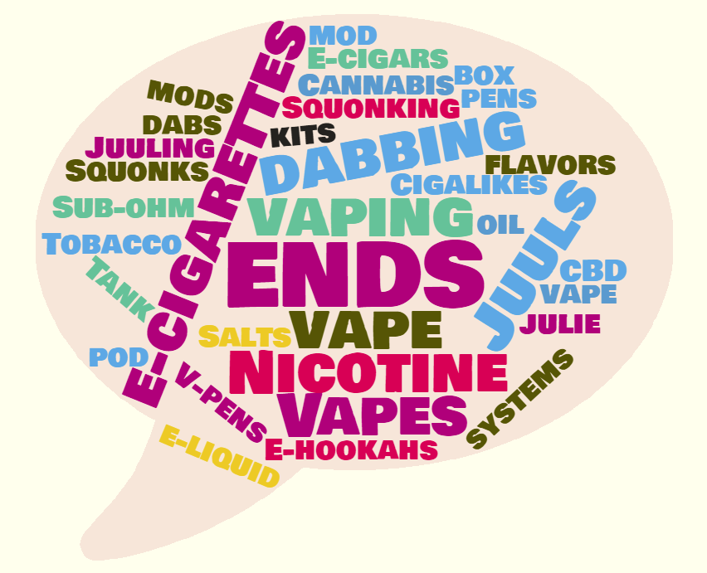
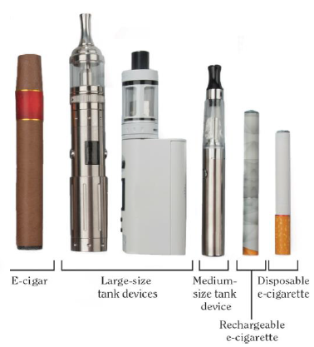
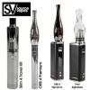
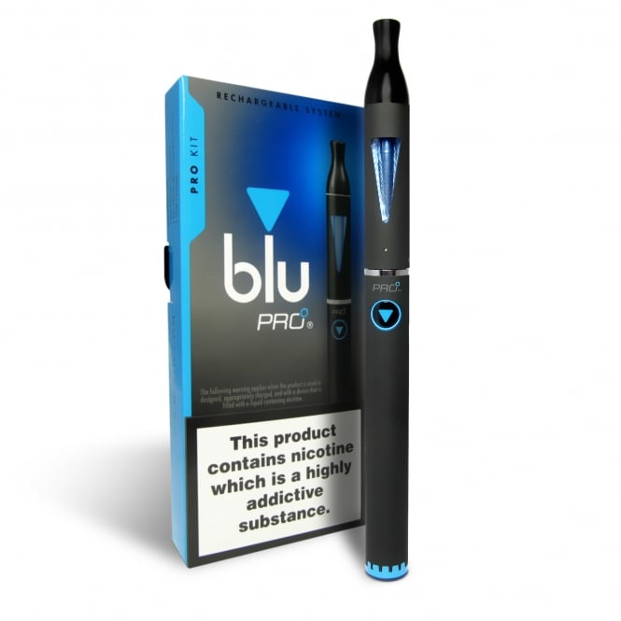
Types of Electronic Nicotine Delivery Systems (ENDS)
Notes:
E-cigarette, or vaping, products can be used to deliver nicotine, cannabis (THC, CBD),
flavorings, chemicals, and other substances.
They are known by many different names and come in many shapes, sizes and device
types. Devices may be referred to as
● E-cigs
● Vapes
● Vape pens
● Tanks
● Mods
● Pod-Mods
● Electronic nicotine delivery systems (ENDS)
A 2 mg Suorin pod contains the equivalent amount of nicotine as three packs of cigarettes

Slide 8
Anatomy of a Pod-Based System
Cartridges/Pods
P
H
I
X
These cartridges/pods contain
J
U
U
L
NICOTINE!
Devices with Rechargeable
Battery
Covers
Slide adapted from:
tobaccopreventiontoolkit.stanford.edu
Notes:
Pod-based systems are made up of two components the part on the left is the power source and contains the battery that can be charged through a USB port.
The smaller piece on the right is the pod or cartridge. A cartridge can provide at least 200 puffs and comes in a variety of different flavored e-juices, all with an alarming amount of nicotine.
These flavors and cartridge cover colors are concerning since they attract young people.
Each JUULpod is packed with 59 milligrams per milliliter of nicotine, which is equal to the amount of nicotine found in a pack of cigarettes. A PHIX pod contains twice that amount………….
This is concerning because we know that the developing teen brain is very sensitive to nicotine and prone to addiction.
A pod holds it’s e-juice in the outer shell. When plugged into the battery piece the e-juice can be heated to produce an aerosol which is then inhaled into the lungs
References:
https://support.juulvapor.com/home/learn/faqs/juulpods-juice
https://phixvapor.com/pages/faq

Slide 9
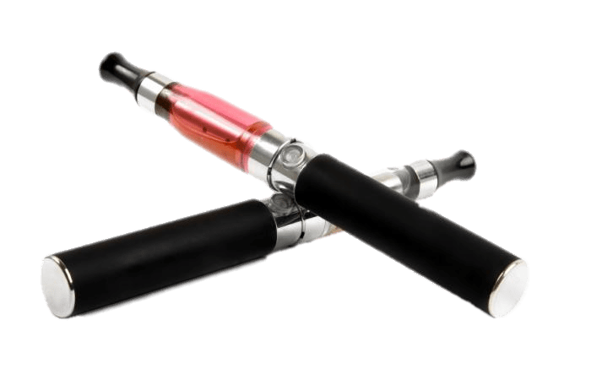
How ENDS Work?
Electronic cigarettes are battery-powered devices that deliver nicotine and/or flavoring to the user in the form of an aerosol (not water vapor).
E-Liquids, when heated, may form additional harmful compounds that are also inhaled by the user.
E-Liquids typically use propylene glycol and/or vegetable glycerin as the solvents for the nicotine and flavoring chemicals
Although these elements are deemed safe in food products, they have not been tested for safety when heated and inhaled into the lungs.
Vaping is actually a misnomer.
ENDS create aerosol, not water vapor.
Aerosol is not harmless. It contains harmful and potentially harmful chemicals in addition to nicotine.
Notes:
ENDS aerosol is not a water vapor and is not harmless.
It can contain harmful and potentially harmful elements in addition to nicotine.
Carcinogens (formaldehyde, acetaldehyde, acrolein) and toxic heavy metals (lead, cadmium) have been found in ENDS aerosols
Ingredient levels vary, due to the lack of manufacturing standards, ingredient levels vary

Slide 10
What’s in Your E-Cigarette?
Most ENDS contain nicotine, the addictive drug in other tobacco products.
The amount of nicotine in ENDS varies widely, based on the e-liquid, the temperature of heating, and the depth of the puff
Nicotine salts can be vaped at lower temperatures for a smoother experience, which allows users to consume higher levels of nicotine with less harshness on the throat.
ENDS can also be used as a delivery system for marijuana and other illicit drugs
50.6% of CT youth reported using their device with a substance other than nicotine, such as marijuana, THC, hash oil, or THC wax.
(2017 CT Youth Tobacco Survey)
Notes:
This 2017 data point drives home the point that ENDS can and have been used as delivery systems for substances other than nicotine.

Slide 11
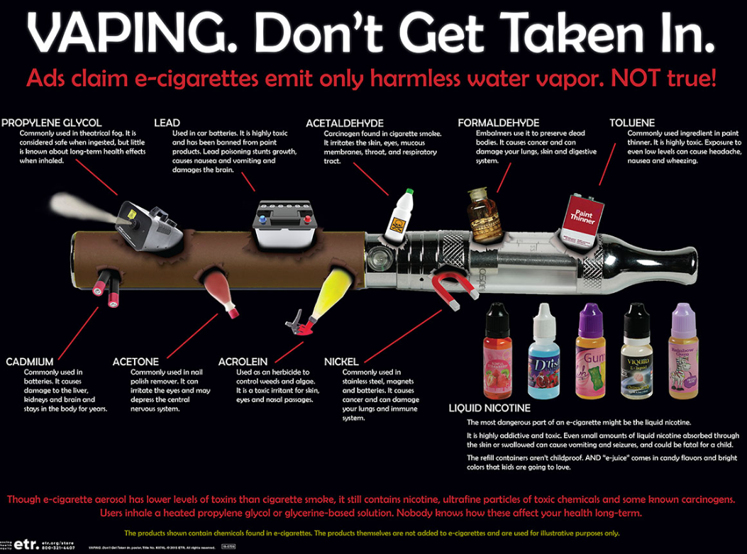
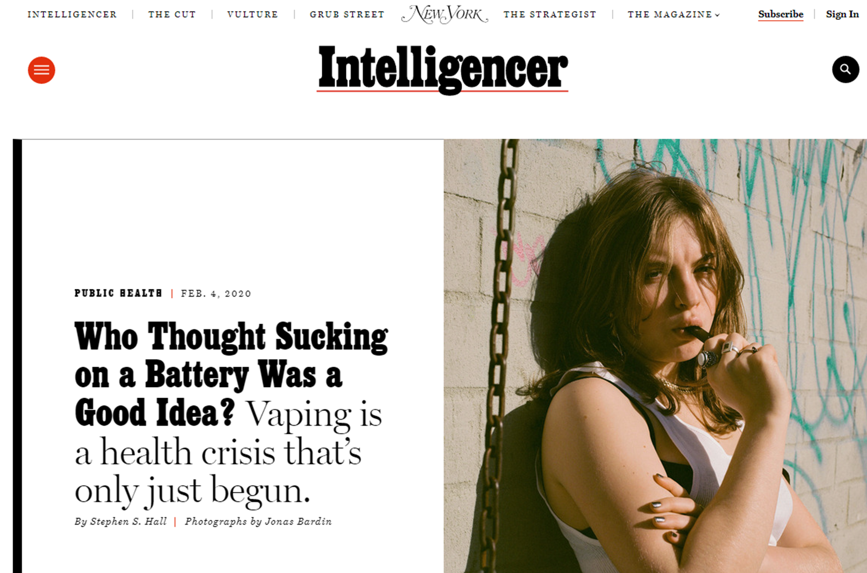
What’s in your E-Cigarette?
Notes:
Toluene - Is added to gasoline, used to produce benzene, and used as a solvent. Exposure to toluene may occur from breathing ambient or indoor air affected by such sources. The central nervous system (CNS) is the primary target organ for toluene toxicity in both humans and animals for acute (short-term) and chronic (long-term) exposures. CNS dysfunction and narcosis have been frequently observed in humans acutely exposed to elevated airborne levels of toluene; symptoms include fatigue, sleepiness, headaches, and nausea. CNS depression has been reported to occur in chronic abusers exposed to high levels of toluene. Chronic inhalation exposure of humans to toluene also causes irritation of the upper respiratory tract and eyes, sore throat, dizziness, and headache. Human studies have reported developmental effects, such as CNS dysfunction, attention deficits, and minor craniofacial and limb anomalies, in the children of pregnant women exposed to high levels of toluene or mixed solvents by inhalation. EPA has concluded that that there is inadequate information to assess the carcinogenic potential of toluene.

Slide 12
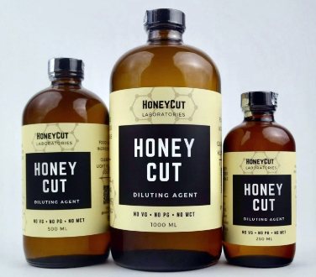
Honey Cut’s ‘complex compound’ turned out to be very simple – and potentially toxic.
Vitamin E Acetate
Notes:
Illicit market THC vapes contained a harmful cutting agent to make the liquid’s viscosity ideal for heating and vaping
vitamin E acetate should not be added to e-cigarette, or vaping, products.
product use–associated lung injury (EVALI).

Slide 13
The Health Effects of ENDS on Youth
The nicotine in E-liquids is toxic;
Vaping has caused middle and high school youth to become ill during the school day, reporting nausea, vomiting, and other symptoms;
ENDs are not strongly regulated, and there is still much unknown about the short and long-term effects of e-cigarette use;
Young people who use e-cigarettes are at risk for long term effects due to exposure to nicotine. These effects include:
Learning and cognitive deficits, memory, attention;
Mood disorders and impulse control;
Increased susceptibility to addictions – nicotine and other substances.
Teens who vape are three and half times more likely to smoke cigarettes³ and almost three (2.7) times more likely to use cannabis.
Did You Know:
Adolescence is a critical time for brain development. Puberty to age 25 is the 2nd highest period of brain growth, after the first five years.
Sources: E-Cigarette Use Among Youth and Young Adults: A Report of the Surgeon General 2016; Berry, et al. 2019; Hongying, et.al, 2019.
Notes:
Nicotine disrupts the development of brain circuits that control attention and learning
Nicotine addiction can occur within one to two days, or even a puff

Slide 14
E-Cigarettes are the most commonly used tobacco product among youth
In the United States, youth are more likely than adults to use e-cigarettes
In 2011, 2.06 million U.S. middle and high school students used e-cigarettes in the past 30 days, including 2.8% of middle school students and 11.3% of high school students. (1)
In 2019, 4.5% o U.S. adults were current e-cigarette users. (2)
In 2019, among current adult e-cigarette users overall (2):
36.9% also currently smoked cigarettes,
39.5% formerly smoked cigarettes, and
23.6% had never smoked cigarettes.
Among current adult e-cigarette users, the percentage who have never smoked cigarettes is highest among those aged 18-24 years (56.0%), and is lower in older age groups. (2)
https://www.cdc.gov/tobacco/basic_information/e-cigarettes/about-e-cigarettes.html
Park-Lee E, Ren C, Sawdey M, et al. Notes from the Field: E-Cigarette Use Among Middle and High School Students — National Youth Tobacco Survey, United States, 2021. Morbidity and Mortality Weekly Report, 2021; 70:1387–9.
Cornelius ME, Wang TW, Jamal A, Loretan C, Neff L. Tobacco Product Use Among Adults – United States, 2019. Morbidity and Mortality Weekly Report, 2020. Volume 69(issue 46); pages 1736–1742. [accessed 2020 November 19].
Notes:
Vaping is the method of delivery.
The legal age for tobacco and nicotine use in Connecticut is 21. Addressing perception of harm and access remains a priority.

Slide 15
2019 Connecticut Youth Risk Behavior Survey Results
1 in 4, 27.8% or 44,300 of high school students used some form of tobacco in the last 30 days, including cigarettes, cigars, e-cigarettes and other electronic vaping devices, hookahs (water pipes), chewing tobacco, snuff, snus, dip, dissolvable tobacco and traditional tobacco pipes
31.2% of female high school students vs 24.6% of male students were current tobacco users
E-cigarettes and other electronic vaping devices (27.0%) were the most commonly used tobacco products, while traditional cigarettes (3.7%) have become one of the least used products
31% of White students, 26.8% of Hispanic students and 19.7% of Black students were current tobacco users
High school students who identified as gay, lesbian or bisexual (40.1%) were significantly more likely than heterosexual (26.5%) students to report current tobacco use
High school students who reported poor mental health during the past 30 days, including stress, depression and problems with emotions, were about twice as likely (32.6%) as their peers without mental health difficulties (16.8%) to have used tobacco
CT DPH 2019 Current Youth Tobacco Use, from 2019 CT Youth Risk Behavior Survey
Notes:
You see recent data points from the Youth Risk Behavior Survey in Connecticut.
Start thinking about how you assessing the prevalence and incidence of vaping in local youth populations.

Slide 16
Trends in Percent of High School Students Reporting Past 30-Day Use of Electronic Vapor Products vs. Cigarettes: CT 2011-2019
Notes:
Show the data so you can then remind folks that vaping, alcohol and adult use cannabis all require a person to be 21-year old (unless a medical exemption exists)
This graph compares the percentage of high school students reporting 30-day use of Electronic Vapor Products versus combustible cigarettes from 2011-2019.
It clearly shows a surge in electronic vapor products in the last few years since the explosion of e-cigarette options that occurred around 2016.
It also highlights that combustible cigarette use among youth is waning.

Slide 17
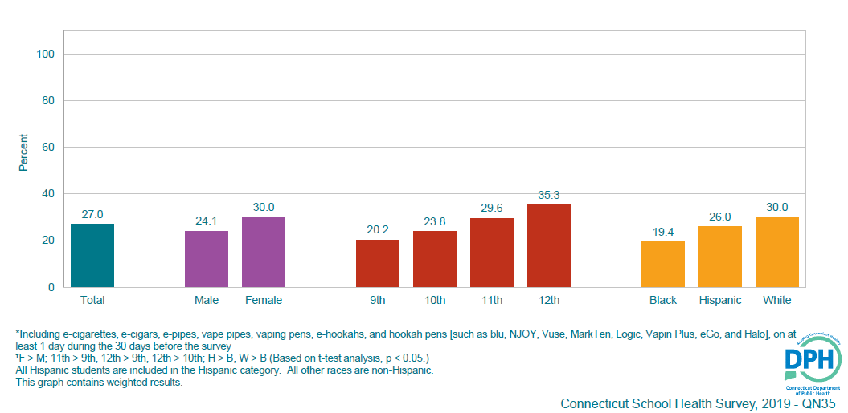
Percentage of CT High School Students who Currently Used an Electronic Vapor Product, by Sex, Grade, Race/Ethnicity 2019
Notes:
This figure showcases the disparity in vape usage among subgroups of the student population.
Students more who reported vaping at elevated rates compared to their peers included:
Female Students
Students at later stages in the education (seen in the incremental climb in usage rates as move from 9th to 12th grade students)
White (non-Hispanic) students
Students who identified as Gay, Lesbian, and/or bisexual

Slide 18
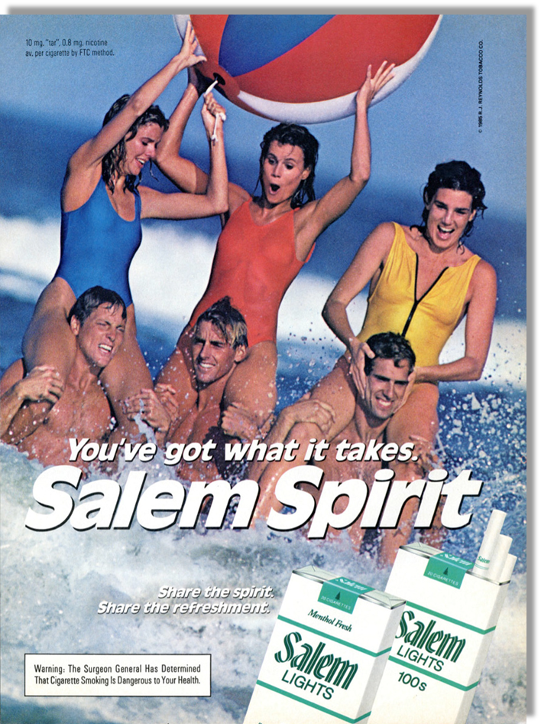
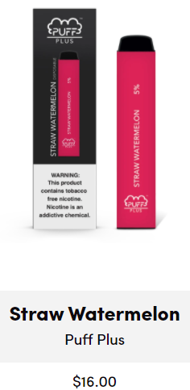
Marketing and Messaging
ENDS manufacturers (including Big Tobacco) are using an old playbook with great success
ENDS products are not yet regulated in the same way as other tobacco products
Lack of regulation over manufacturing standards, ingredients, and sales restrictions have helped to create a billion dollar and growing vaping industry.
A recent study found that Juul stood out from other e-cigarette companies by marketing its devices on social media platforms such as Twitter, YouTube, and Instagram.
That marketing campaign was a big success, the study suggests, with Juul's social-media activities being "highly correlated" with sales.
Notes:
Similarities in marketing approaches between cigarettes and e-cigarettes include use of bright colors, and graphics that appeal to young consumers. Exploited social media – young people forward to friends & followers;
Paid social media influencers, people with large number of followers, to post on social media;
Created Juul #hashtags to drive social media, connect to other posts.
Juul terminated Instagram and Facebook accounts in Nov. 2018
Now youth and 3rd party companies drive social media. Ex: Vaping juice company #juul.

Slide 19
Know the Law
Tobacco
Must be 21 to purchase tobacco products
Cannabis
Adults over the age of 21 can have as much as 1.5 ounces on their person and can transport up to 5 ounces in a locked trunk or glove box in their vehicle. In July 2023 adults can grow as many as six plants in their home (maximum of 12 plants)
Alcohol
Must be 21 to purchase or possess alcohol
Gambling
Must be 21 to participate in online or in-person casino gaming or sports wagering and at least 18 years old to participate in fantasy contests, purchase a lottery ticket, or play keno.
Handguns
Must be 21 to obtain an eligibility certificate for a handgun
Law prohibits any person from selling, bartering, lending, giving, delivering or otherwise transferring any handgun to a person under age 21
Notes:
21 years of age is a common reference point for limiting access to alcohol, tobacco, other drugs, gambling, and handguns. These laws come with consequences including fines and civil penalties.

Slide 20
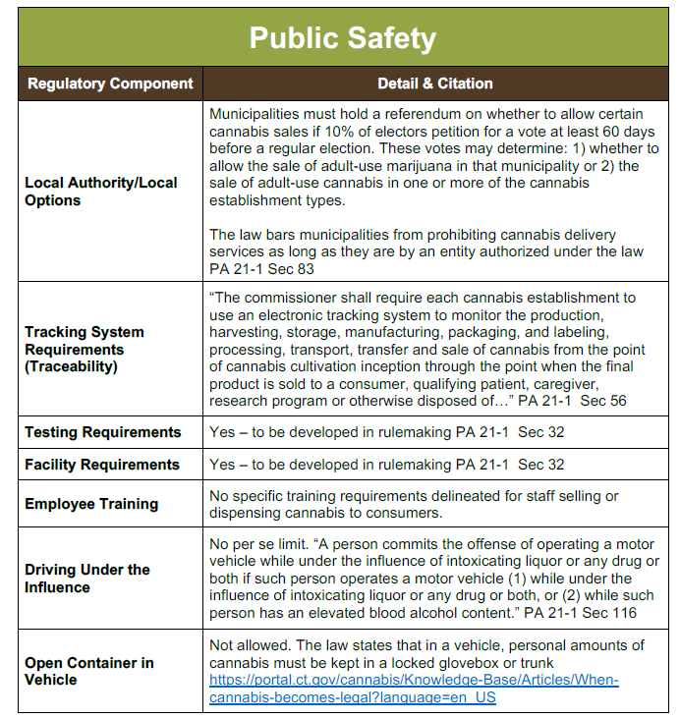
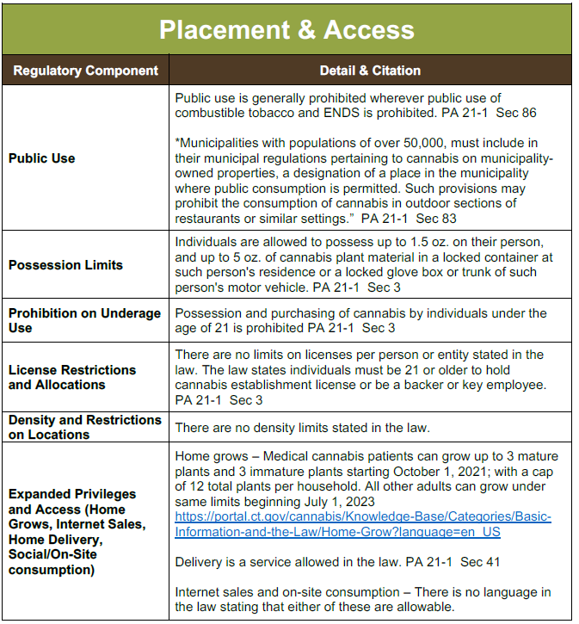
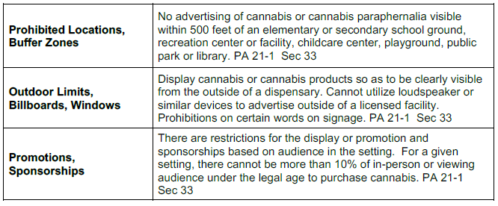
Law and Policy (Cannabis)
Notes:
Roll-out of adult use cannabis will continue to affect communities in the upcoming years – public spaces in large urban centers and legalization of grow at home for a minimum number of plants.

Slide 21
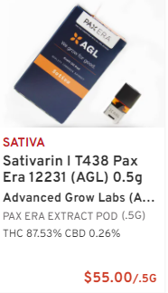
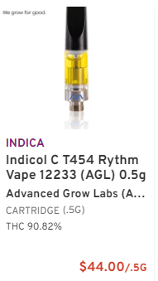
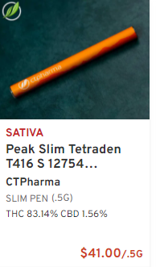
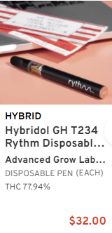
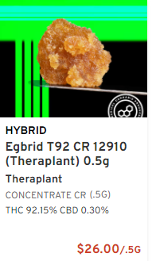
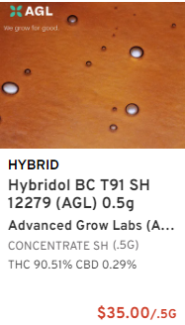
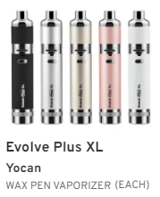
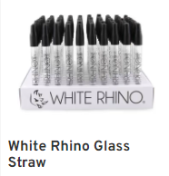
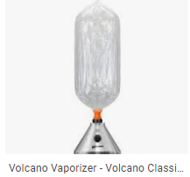
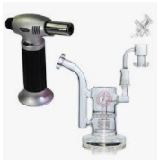
Cannabis Vaping Options
Notes:
Displayed here are a variety of cannabis items related to vaping. Starting at the top left, referred to as a “PAX”, this item mimics the Juul pod and will fit only those systems or “batteries”. Also notice the THC strength in each of these products. This first one being 87.53% pure THC. The second item is a “screw on” style cartridge that is meant to fit a rechargeable battery or “pen”. Very similar to the first item, but specific to a “pen style” system. The next two item are disposal style systems, or systems that do not have a rechargeable battery. The last two items on the top row are examples of other forms of THC that can be vaped. The first is called crumble and the other is called shatter. They get their names because of their consistency which is representative of their extraction/purification methodology. These forms of THC can be vaped in a “pen style” delivery system pictured below, or they can be vaped in the form of a “dab” (see picture below), or they can be vaped in the form of “free basing” using the glass straw pictured below. (The end of the straw is heated with a torch style lighter to produce maximum heat and the hot tip touches the THC product while the user inhales on the opposite end. Lastly pictured is the Volcano style vaporizer. This unit is plugged into an electrical outlet and the vapor is captured inside a plastic bag which the user inhales. Typically this is used to vape cannabis plant or flower instead of concentrates.

Slide 22
Past Year Cannabis Use by Age Group: CT vs US, 2008-2018
Source: NSDUH, 2018
Notes:
Connecticut exceeds national averages for each of the age groups. Enough said.

Slide 23
Cannabis: Risk and Impact
Risk Factors
Effects and Impacts
Availability of marijuana;
Favorable parental attitude towards marijuana;
Academic failure;
Peers who use marijuana;
Low peer disapproval of marijuana use;
Prior use of alcohol/tobacco;
Anxiety and depression;
Sensation-seeking behavior and impulsivity;
Child abuse/trauma
Impaired learning and coordination;
Sleep problems;
Increased risk of use of other illicit drugs;
Potential for addiction to marijuana, as well as other substance use disorders;
Increased risk of bronchitis and chronic cough

Slide 24
Recent Vaping News in CT
Notes:
Unfortunately fentanyl has found its way into THC vapes and is causing serious harm to teens.
Cross contamination seems to be the reason this is happening. Meaning the person selling the vape pens may also be selling or handling fentanyl.

Slide 25
Segment 2: Prevention Basics
Substance Misuse Prevention
Relevant Definitions
Why are strategic substance misuse prevention efforts effective?
Socio-Ecological Model in Prevention
Levels of Influence
Risk Factors (RF) and Protective Factors (PF)
Example Risk and Protective Factors
Strategic Prevention Framework
Key players in Prevention in Communities
Local Prevention Councils & Community Substance Abuse Prevention Coalitions
Organizing the 12 Sectors
Notes:
For more information participate in our Prevention 101 training hosted a few times through the year or visit our youtube channel to view past prevention 101 trainings
Training Presentation: https://preventiontrainingcenter.org//images/tools_menu/tools_menu_image/2325-1634923566-prevention%20101%20oct%202021%20(pdf%20slides).pdf
Archived Video: https://www.youtube.com/watch?v=BOxthBAA9ds

Slide 26
Substance Misuse/Use Prevention Basics
Definition of Substance Misuse Prevention
Strategic prevention efforts work because they are
Coordinated activities, programming, and community change efforts that promote health by keeping people and communities from moving into substance misuse.
Prevention is a combination of policies, programs, and practices that target individuals, families, and communities to stop or delay first use of substances and promote mental health.
Data Driven: A strategic prevention effort assesses its locality for its:
Areas or substances of concern
Prevalence of substance use and/or misuse
Circumstances that either increase or decrease the possibility (Risk and Protective Factors)
Intentional and Planned: These efforts have several research studies that assert their effectiveness.
Coordinated Efforts: They organize and mobilize people across varying sectors to maximize effectiveness.

Slide 27
Socio-Ecological Model
People interact with and are impacted by different social groups or environments
Each level in the socio-ecological model has the capacity to influence healthy and risk-taking behaviors
Individual – Biological & Physical
Relationship – Family, Caregivers, Friends, Teachers, Coaches, etc.
Community – School, Neighborhood etc.
Society – Laws, Policies, Norms, etc.
Risk Factors – Characteristics at the biological, psychological, family, community, or cultural level that increase the possibility for individual substance misuse.
Protective Factors - Characteristics that decrease the possibility for individual substance misuse
Adapted from the Substance Abuse and Mental Health Services Administration’s (SAMHSA) Guide to SAMHSA’s Strategic Prevention Framework
https://www.samhsa.gov/sites/default/files/20190620-samhsa-strategic-prevention-framework-guide.pdf
Notes:
The socio-ecological model shows the different environments that influence youth development.
These different social-ecological levels each have risk and protective factors that influence youth knowledge, attitudes, healthy behaviors.
These risk and protective factors become the target for our prevention initiatives.
Best practices include targeting more than one socio-ecological level.

Slide 28
Vaping Risk Factors by Socio-Ecological Level
Individual Level
Community Level
Perceive vaping as safe and less risky than combustible tobacco
Subpopulations based on data – LGBTQ+ youth and white, non-Hispanic youth have higher rates
Age of first use & adolescent brain – more vulnerable to addiction because brain is developing.
Nicotine changes the structure of brain to increase vulnerability to other substances
Retail access – even with Tobacco 21, some stores sell to underage youth
Social access at school – share, obtain, or purchase from friends
School & workplace policies that do not prohibit vaping as part of tobacco free policies
Regulatory: labeling, pricing, taxes
Relationship Level
Society/Cultural Level
Perception of peer approval
Perception of parent approval
Observing parents use
Social access – obtain vapes from friends and/or parents
Social culture of vaping with peers
Social media vaping marketing targeting youth and young adults. Many using tobacco marketing practices from the past.
Social culture of vaping through online communities
Online accessibility of vapes
Reducing Vaping Among Youth and Young Adults (SAMHSA)
Notes:
Risk factors increase the possibility of vaping and substance use.
The more risk factors, the greater the possibility.
Risk factors occur at different socio-ecological levels or spheres of influence.
Prevention strategies target these risk factors. Local data helps us prioritize which factors to target.
Effective prevention programs target more than one socio-ecological level.

Slide 29
Vaping Protective Factors by Socio-Ecological Level
Individual Level
Relationship Level
Community/Society/Cultural
High perceived risk of harm
Belief in a moral order
Prosocial involvement
Academic success
High commitment to school
Peer unfavorable attitudes towards substance use
Being perceived as “cool” for prosocial involvement
Interaction with prosocial peers
Family attachment
Prosocial opportunities with family
Prosocial rewards from family
Laws and regulations that limit access and usage of substances
Norms that deem substance use as unfavorable
Adolescent Risk and Protective Factors for the Use of Electronic Cigarettes
Notes:
Protective factors reduce the impact of risk factors and can be targeted by prevention initiatives as well to prevention or reduce vaping use.
Just like risk factors, protective factors occur in the different socio-ecological levels or spheres of influence.
Effective prevention programs target more than one level.

Slide 30
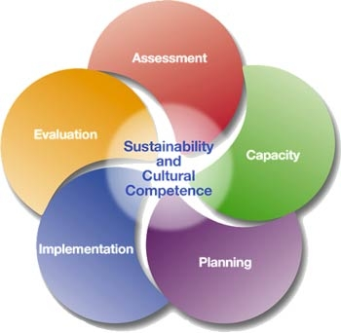
Strategic Prevention Framework (SPF)
Assessment: Collect data to identify local needs including priority substance, target population, risk factors and protective factors. Collect data on community readiness and existing prevention resources.
Capacity: Create or strengthen community-based prevention team and increase awareness and support for prevention in the community.
Planning: Select evidence-based prevention policies, practices and program that best fit – address risk factors (conceptual fit) and will work in the community (practical fit).
Implementation: Determine who will deliver what prevention initiatives when and where. Offer training and support. Check for fidelity to program design.
Evaluation: Assess program implementation (process evaluation) and changes in risk factors (short term outcomes) and reductions in substance misuse (long term outcomes).
Cultural Competency and Sustainability are two guiding principles of the SPF
Notes:
The Strategic Prevention Framework is the five step public health planning model used at the national, state and local level to prevention and reduce substance use.
It uses community coalitions with diverse members who share data and expertise to identify priority substances, target population, and risk factors, the local factors contributing to substance use in our community.
Coalition members collaborate on a plan to reduce the risk factors and strengthen protective factors and on implementation or sharing the prevention work.
Evaluation is critical to see if we implemented our prevention initiatives as intended and if we are meeting our goals and objectives.

Slide 31
Local Prevention Councils and Community Coalitions
Local Prevention Councils (LPCs) and Community Substance Abuse Prevention Coalitions are community-based prevention team that assess local substance misuse needs and implement prevention initiatives.
LPCs are funded by the Connecticut Department of Mental Health and Addiction Services (DMHAS) & Regional Behavioral Health Action Organizations (RBHAOs).
Many coalitions apply for other funding
12 Community Sectors
Youth
Youth Serving Organizations (YSOs)
Local Government
Civic/Volunteer Organization
Parents
Law Enforcement
Business
Media
Educators
Health Care
Faith Based Organizations
Substance Misuse Prevention
Notes:
The 12 community sectors represent a range of residents and organizations who have information and resources that can be applied to substance misuse prevention.
Bringing the sectors together combines their different knowledge about local conditions and their skills and resources to make a difference.
Sector representatives and/or coalition members take ownership of the local substance misuse issues & prevention initiatives

Slide 32
Segment 3: Evidence Based Strategies/Practices
Definitions of Evidence Based Prevention Strategy
Why EBPs are effective?
Evidence Based Prevention Strategies
Best Practices
Examples by Socioecological Level
Prevention Education Curricula
Community Prevention Strategies

Slide 33
Evidence Based Prevention Strategies
Definitions:
Evidence-Based Substance Misuse Prevention Strategies are effective because:
Evidence Based Prevention Strategies have been evaluated and demonstrated to be effective in preventing health problems based upon the best-available research evidence.
The Strategies have been implemented several times over in various contexts to confirm that their implementation leads to the desired outcome.
They decrease the effect and/or prevalence of risk factors (circumstances that place individuals at increased risk or substance misuse) at each level of the socio-ecological model.
They increase the effects and/or prevalence of protective factors (circumstances that decrease likelihood of individual substance use) at each level of the socio-ecological model.

Slide 34
Evidence Based Vaping Prevention Strategies
Best Practices Address and/or Leverage the Following:
Knowledge
Attitudes
Behavior
Self-Efficacy
Developmental History
Age
Values
Goals
Expectations
Stigma
Peer Influences
Perceptions of Harm
Refusal Skills Training
Commitments & Intentions not to use
Flavored Tobacco
Disposable ENDS
Use of Peer Leaders
Active discussions and role-playing activities
Marketing
Local Policy Intervention
Accessibility of Tobacco Products
A Breath of Knowledge: Overview of Current Adolescent E-cigarette Prevention and Cessation Programs
Notes:
Examples of risk and protective factors, prevention strategies and outcomes.

Slide 35
Evidence Based Vaping Prevention Strategies (Tobacco) - Examples by Level
Individual Level
School Level
smokeSCREEN | Online Game | Developed by Yale Center for Health and Learning Games
Aimed at changing risk perceptions, beliefs, and knowledge about e-cigarettes to reduce early adolescent smoking and nicotine vaping.
Tobacco-, Smoke-, and Vaping-free campus policies
Prohibit acceptance of any donations or curriculum from any tobacco-related industry
Tobacco Prevention Toolkit | Developed by Stanford School of Medicine
Theory-based and evidence-informed resources created by educators, parents, researchers aimed at preventing middle and high school students’ use of tobacco and nicotine
Project ALERT (Adolescent Learning Experiences Resistance Training) | Developed by RAND Corporation
Project ALERT addresses the pro-drug mindset of today’s teens and effectively increases their likelihood to remain drug-free.
School Level
CATCH My Breath | School-Based Education | Developed by the University of Texas School of Public Health
Classroom lessons are based on cooperative learning, group discussions, goal setting, classmate and adult interviews, and activities like analyzing tobacco and nicotine vaping advertising and developing counter-advertising messages.
Notes:
Vaping prevention strategies can target different socio-ecological levels or spheres of influence.

Slide 36
Evidence Based Vaping Prevention Strategies (Tobacco) - Examples by Level
Community Level
The Real Cost of Vaping | Resources for Educators (infographics) | Developed by the Food and Drug Administration
Provide high school and middle school educators with resources such as fact sheets, lesson plans, and activity sheets to help educators start educational conversations about the harms of youth e-cigarettes use.
The truth® Campaign | Counter-marketing campaign | Developed by the Truth Initiative
Prevention messages are aired across television and digital platforms targeted to youth and young adults, ages 15-24. The messages describe the harms associated with smoking and nicotine vaping.
Pricing policies that can determine minimum prices and tax rates for products
Zoning/licensing laws that limit the number and locations of retailers able to sell products
Minimum legal purchasing age can be set and enforced
Clean air laws can be enacted to restrict vaping in public/private places
Bans on advertising for vaping
Laws on packaging for vaping-related products
Point of sale laws, including limiting where vaping product can be sold within a store
Banning flavors
Increased compliance checks

Slide 37
Vaping Prevention: What Can We Do About It?
Parents
Be tobacco free; its never too late to quit
Talk to your kids about why vapes/ENDS are unsafe
Tell your kids that you do not want them to use vapes/ENDS
Set clear rules that discourage vapes/ENDS use
Safely store cannabis in home if you have children
Schools
Administrators:
Policies
It is illegal to sell tobacco or vaping products to anyone under 21.
100% tobacco free school and grounds polices: 24/7/365
Teachers:
Watch for ENDS use and enforce school policies.
Teach the hazards of ENDS use.
Youth prevention education in schools should follow best practice recommendations
Communities
Implement evidence-based prevention strategies that are known to reduce tobacco use, including:
Pricing
Strong smoke-free laws and policies
Social marketing campaigns to increase perception of risk/harm
Enforce the tobacco sale age to 21 that took effect October 1, 2019
Adopting tobacco-free/vape-free policies and promoting tobacco free lifestyles is still a best practice
Notes:
Youth are especially susceptible to price
The less youth see smoking/vaping, the less likely they are to use.
9 out of 10 adult smokers begin by age 18.
Bridgeport, Hartford, Milford, Southington, South Windsor, Trumbull and Wallingford were the first communities to prohibit the sale of tobacco products to those under age 21 (Truth Initiative) and helped create the momentum for the state to pass the Tobacco 21 law. Two other factors were the vaping lung illness crisis and discussion at the federal level to increase the age, too.

Slide 38
Prevention Education Curricula
The Real Cost of Vaping
Catch My Breath
Provide high school and middle school educators with resources such as fact sheets, lesson plans, and activity sheets to help educators tarts educational conversations about the harms of youth e-cigarettes use.
Classroom lessons are based on cooperative learning, group discussions, goal setting, classmate and adult interviews, and activities like analyzing tobacco and nicotine vaping advertising and developing counter-advertising messages.
Know the Risk: A Youth Guide to E-Cigarettes
SmokeScreen
Educate youth on e-cigarettes, including the health risks, the factors that lead to e-cigarette use, and what youth can do to avoid all tobacco products, including e-cigarettes.
Aimed at changing risk perceptions, beliefs, and knowledge about e-cigarettes to reduce early adolescent smoking and nicotine vaping.
Tobacco Prevention Toolkit
Theory-based and evidence-informed resources created by educators, parents, researchers aimed at preventing middle and high school students’ use of tobacco and nicotine.
Notes:
You can link directly to these prevention curricula to learn the target age, number of sessions, cost, etc.

Slide 39
Community Prevention Strategies
Provide information on risk of tobacco & ENDS and promote cessation services through:
Social Media & Social Marketing Campaigns
Community forums and other trainings
Community health fairs and other events
Write op-ed articles in local newspaper
Ask community partners to share information (health department, library, schools, etc.)
Conduct tobacco/ENDS merchant training to increase compliance with tobacco/ENDS sales laws
Partner with police department to conduct merchant compliance checks and recognize merchants who pass compliance checks. Offer training prior to checks and to those who do not pass
Provide an enforce signage related to tobacco/ENDS free policies including We Card signs to merchants
Restrict point of purchase/promotion
Review public/school policy pertaining to substance use and misuse and include opportunities for intervention
Offer tobacco/ENDS intervention and cessation groups
Notes:
Individual prevention strategies, such as information dissemination, community forums, health fairs, etc. target individual people to increase knowledge, change attitudes and choose healthy behaviors.
Environmental strategies such as social marketing campaigns, merchant compliance checks, updating policy and implementing new ordinances and laws, change community norms, reduce access to substances and provide a supportive environment for making healthy choices.

Slide 40
Segment 4: Measures and Metrics
SAMHSA Vaping Resource Guide
Supply (e.g., access points, cost, enforcement, policies)
Demand (e.g., awareness, attitudes, behaviors, age of first use, use patterns, treatment

Slide 41
Core Prevention Measures
30-Day Use
Perception of Risk (from)
Alcohol
Cigarette
Other tobacco products
Cannabis
Illicit drugs other than cannabis
Alcohol
Cigarettes
Cannabis
Disapproval of Using & Perception of Peer Disapproval of Using
Age of First Use
Alcohol
Cigarette
Other tobacco products
Cannabis or hashish
Heroin
Alcohol
Cigarettes
Cannabis (experimentally)
Other
Age of First Misuse
Average daily school attendance rate
Alcohol-related traffic fatalities
Alcohol and drug-related arrests
Exposure to prevention messages
Family communication around drug and alcohol use
Youth
Ages 12 to 17
Prescription pain relievers among past year initiates
Source: Substance Abuse Prevention Treatment Block Grant
Notes:
The federal government uses a cluster of core prevention measures across alcohol tobacco and other drugs. Vaping is a method of delivery – typically for nicotine and more recently for other substances. The four core measures are 30 day use, perception of risk, perception of peer disapproval and perception of parent disapproval.
Information to answer these questions is typically collected through student surveys, adult/community surveys, or more focused surveys within specific subpopulations via program, service, or healthcare providers who may ask these type of questions as part of their intake and/or screening process.
Other methods to understand emerging patterns or trends involved focus groups or key informant interviews. Training exists to help build skills and capacity in these qualitative data collection areas.

Slide 42
Examples of Other Metrics and Measures
Environmental
Policies (community, school)
Taxes
Zoning ordinances
# of distribution points
Pricing
Health Related
Requests for cessation / treatment
Treatment capacity
Overdoses / poisoning
Long-term health impacts
Economic impact (costs)
Enforcement
Priority
Capacity
Consequences (e.g., restorative, punitive, financial)
Source: Substance Abuse Prevention Treatment Block Grant
Notes:
Other factors to consider relate to environment and accessibility. These are areas often explored during the needs assessment process (of the Strategic Prevention Framework) and then documented in the context of the evidence-based strategies used in the community to reduce the adverse affects of vaping.

Slide 43
Segment 5: What’s Next
Awareness and resource/information sharing
Anchoring the work to the SPF

Slide 44
What’s Next?
Apply the Strategic Prevention Framework (SPF)
Assess youth use and local risk factors influencing their use
Ask what do youth and school administrators observe?
Does school health or prevention curriculum cover vaping?
What current vaping prevention initiatives exist and what organizations are implementing them?
Ongoing assessment as vaping devices, substances and where youth access change
Share data regarding use and stories with policymakers to build support for vaping prevention initiatives
Check RBHAO for regional initiatives and other LPCs/Coalitions
Check CT Clearinghouse for resource materials
Notes:
Where do we go from here? We have increased our knowledge about vaping.
How can we prevent and reduce vaping in our community? We apply the Strategic Prevention Framework to (1) determine the extent of use (30 day use), (2) identify the local risk factors associated with vaping use – what contributes to vaping use in our community, and (3) select evidence based prevention strategies to reduce these risk factors. In SPF step 1 Assessment, we collect data about vaping use, the local risk factors, and current resources and initiatives targeting vaping.
Your RBHAO has additional data and resources to help with this process. The CT Clearinghouse has a variety of resources. The next slide has resources to help you learn about and apply the SPF.

Slide 45
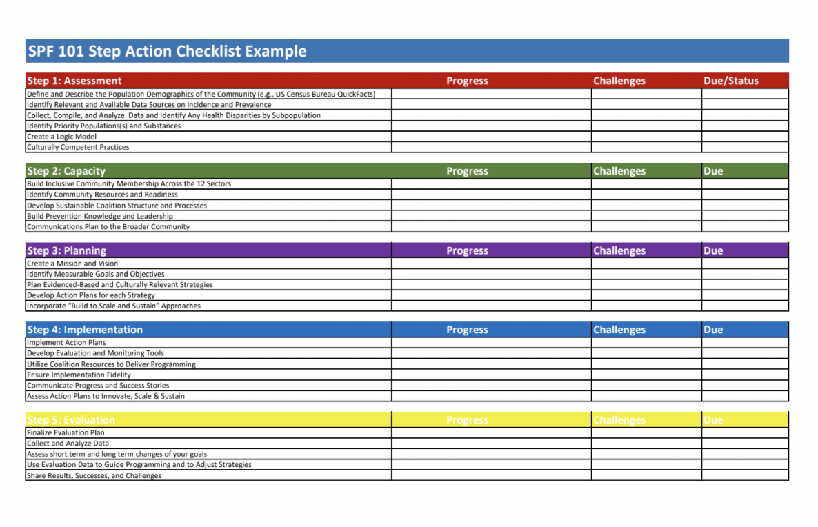
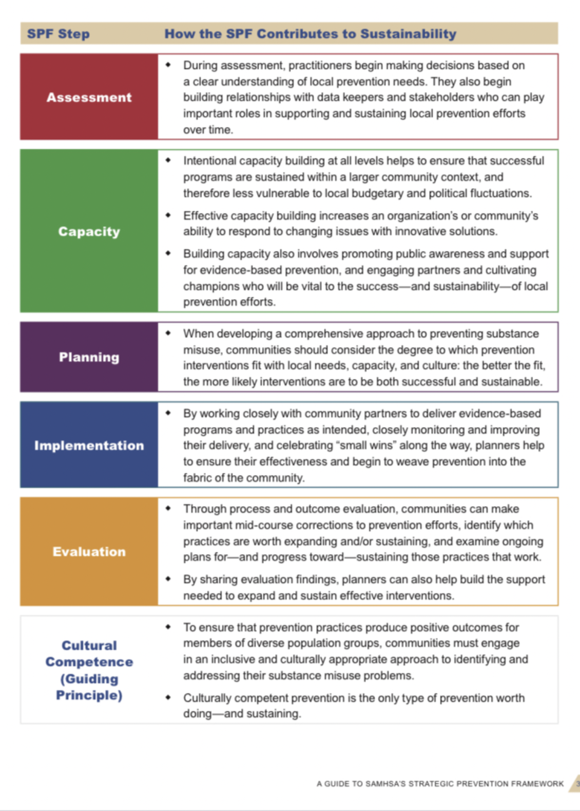
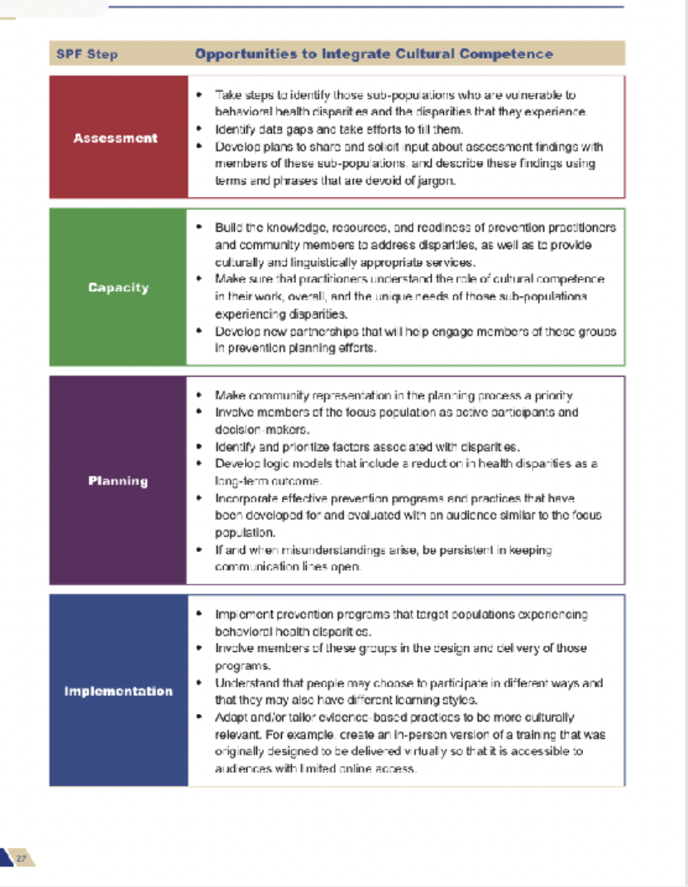
Strategic Prevention Framework Resources
Strategic Prevention Framework 101 – Presentation
SPF & Sustainability Chart
SPF & Cultural Competence Chart
SPF 101 Step Action Checklist
Notes:
The Prevention Training & Technical Assistance Service Center (TTASC) has a SPF 101 presentation – both uploaded to YouTube and presentation slides and other resources to help you learn about the SPF and share the information with colleagues and coalition members. Preventiontrainingcenter.org

Slide 46
Vaping Prevention Resources
Cruise into Communication Messages
Tips on having prevention conversations with:
Teens | Young Adults | Pre-Teens
Marijuana Prevention
TTASC Marijuana – Changing the Conversation Between Youth & Adults
EmpoweringParents – How to Talk to Your Child About Marijuana: 4 Responses for Parents
How Marijuana Legalization Could Change The Way Parents Talk to Their Kids About Pot
New England Prevention Technology Transfer Center | Summary of Marijuana Law
Connecticut Vaping Resource Committee
The Vaping Resources Committee’s goal is to gather, consolidate, and where necessary, create fact-based effective resources for consistent use across the state to address the vaping crisis in Connecticut:
Resource Webpage
TTASC What You Should Know About Vaping Video
TTASC Prevention 101 Training Presentation
Notes:
Additional resources for talking with youth and young adults about vaping and marijuana.

Slide 47
Vaping Prevention & Cessation Resources
INDEPTH: An Alternative to Suspension or Citation
American Lung Association
N-O-T: Not On Tobacco
American Lung Association
Intervention for Nicotine Dependence: Education, Prevention, Tobacco and Health (INDEPTH) is a new alternative to suspension of citation that helps schools and communities address the teen vaping problem in a more supportive way
Click here to learn more
Proven teen smoking and vaping cessation that takes a holistic approach with each session using different interactive learning strategies based on Social Cognitive Theory of behavior change that can then be applied and practiced in everyday life and encourages a voluntary change for youth ages 14 to 19.
Click here to learn more
Notes:
Additional resources for talking with youth and young adults about vaping and marijuana.

Slide 48
Tobacco Cessation Resources
Commit to Quit
Truth Initiative
SmokeFree
Become an EX
DPH sponsors a statewide tobacco use cessation telephone quitline: 1-800-QUIT-NOW or via COMMITTOQUITCT.COM
Prevention messages are aired across television and digital platforms targeted to youth and young adults, ages 15-24. The messages describe the harms associated with smoking and nicotine vaping.
US Department of Health and Human Services website with customized FREE online resources for when teens, veterans, seniors, and Spanish language resources.
Online software that allows you to create a customized quitting plan that grows and learns as with you.
Notes:
The Truth Initiative recently reported that 50% of youth who vape want to quit. The Truth Initiative has a text based system to support youth and young adults as they attempt quitting. Another resource is the American Lung Association.

Slide 49
Connecticut Resources
CT Department of Mental Health & Addiction Services (DMHAS)
Vaping Resources Information and Resources
CT Tobacco Prevention & Enforcement Program
CT Department of Public Health
Tobacco Control and Prevention Program
CT Clearinghouse
Phone: 1-800-232-4424
Website: ctclearinghouse.org
CT Regional Behavioral Health Action Organizations
CT Prevention Training & Technical Assistance Service Center

Slide 50
Other Resources
Centers for Disease Control and Prevention (CDC)
Food and Drug Administration (FDA) Center for Tobacco Products
Campaign for Tobacco Free Kids
Stanford University School of Medicine
Tobacco Prevention Toolkit (teaching modules include vaping)
Parents Against Vaping
The Truth Initiative

