Slide 1
Fundamentals of Vaping/Electronic Nicotine Delivery Systems (ENDS) Prevention – For Parents
Insert Organization Name and Logo
Insert Presentation Date
Notes:
Highlighted sections must be customized by presenter

Slide 2
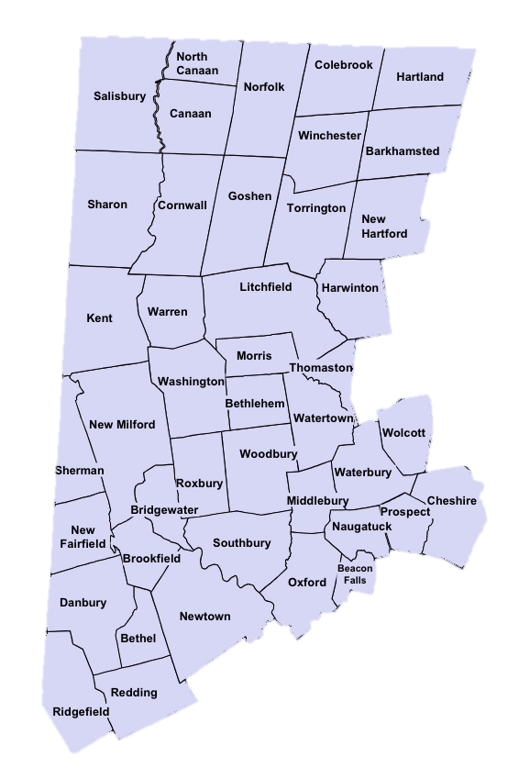
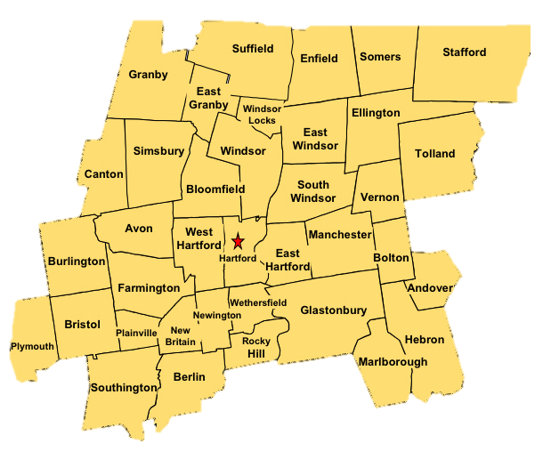
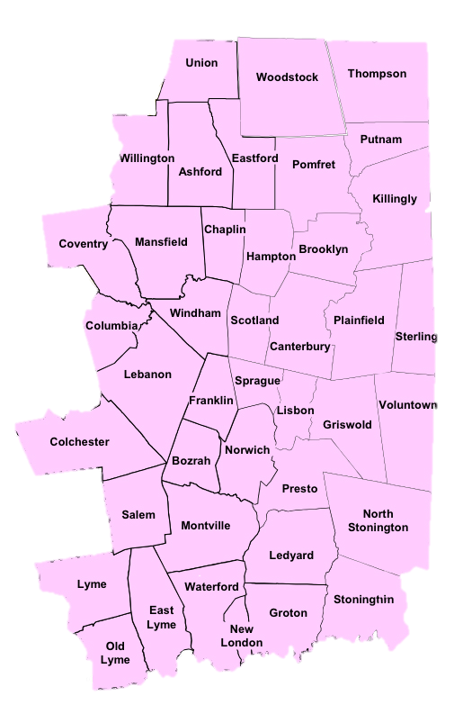
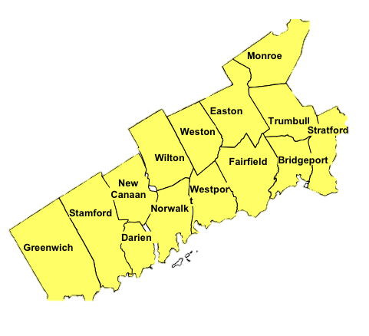
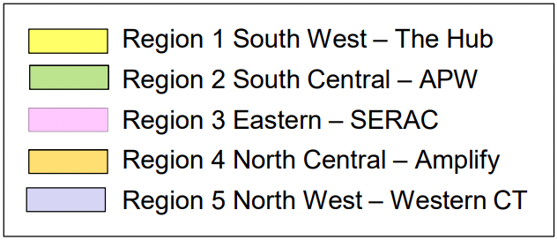
Organization Name
Organization Description
Region Served
Contact Information
Regional prevention infrastructure with five “Regional Behavioral Health Action Organizations”
Notes:
Highlighted sections must be customized by presenter
This RBHAO map/image is split up into sections that allow you to separate and highlight the region of interest.

Slide 3
Coalition Name or Local Prevention Council Municipality
Coalition and/or LPC Description or Mission
Affiliate Organization Name
Contact Info
Additional Info
How to participate or join?
When you meet?
Notes:
Highlighted sections must be customized by presenter
Insert organization specific icon or image to the right

Slide 4
Learning Objectives
Know the law
Electronic Nicotine Delivery Systems (ENDS) Fundamentals
Identify short and long term effects
Use data to understand current use among youth and special populations
Identify risk and protective factors associated with vaping
Strategies for parents to communicate with children, schools, and community about vaping
Provide additional resources
Notes:
The learning objectives for this presentation as follows:
Familiarize yourself with the law regarding tobacco/vape use
Gain a basic understanding of electronic delivery systems (ENDS)
Identify the short- and long-term health effects associated with vape/END usage
Review vape use survey data to identify usage trends among subgroups or special populations
Identify the risk and protective factors associated with vaping
Review strategies for parents to communicate with their children, schools, and community about vaping prevention.
Provide additional resources for future learning

Slide 5
Agenda
Section 1: What are Electronic Nicotine Delivery Systems (ENDS)?
Section 2: Understanding why kids vape
Section 3: How parents can play a role in prevention?
Section 4: Parent/Guardian and Child Communication Tips by Age Group
Section 5: Resources
Notes:
To accomplish the forementioned learning objectives, we will proceed with the following agenda:
In section 1, we will get to know the basics regarding Electronic Nicotine Delivery Systems
In section 2, we will review several of the reasons why kids/youth vape
In section 3, we will cover various vape prevention strategies that parents can implement
In section 4, we will do thorough review of communication tips for parents when talking about substance/vape use prevention with their children
In section 5, there will be several resources for future learning, advocacy, organizing, and prevention

Slide 6
Section 1: Electronic Nicotine Delivery Systems (ENDS) and What You Need to Know
Know the Law
E-Cigs
Cannabis
Alcohol
Gambling
Handguns
Types of Electronic Nicotine Delivery Systems (ENDS)
How do ENDS Work?
What is in an E-Cigarette or ENDS?
Cannabis Vaping Options
Data on Youth Use with a focus on priority groups
Health Effects of ENDS
Notes:
We begin with section in which we will review the following:
The law regarding use, purchase, and/or engagement in with the following E-Cigs, Cannabis, Alcohol, Gambling, and Handguns
The various types of ENDS that are on the market
How the ENDS work?
What’s in an ENDS?
Some of the cannabis vaping options that are on the market as well
Data on youth vaping with special attention on priority groups
And the consequences to health associated with vaping

Slide 7
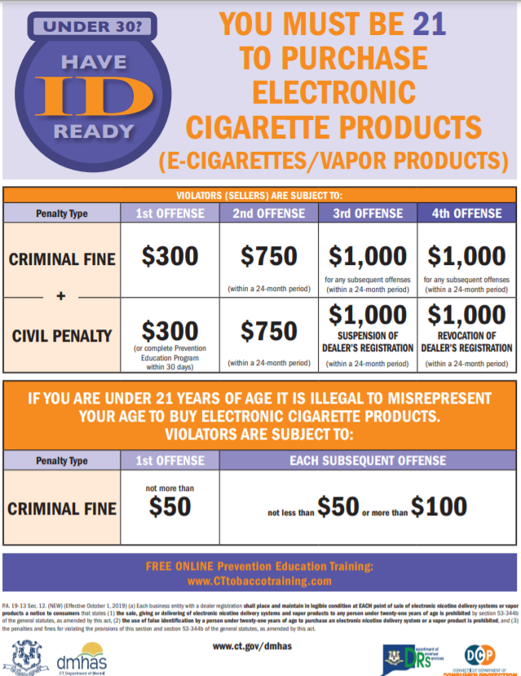
Know the Law
Tobacco
Must be 21 to purchase tobacco products
Cannabis
Adults over the age of 21 can have as much as 1.5 ounces on their person and can transport up to 5 ounces in a locked trunk or glove box in their vehicle. In July 2023 adults can grow as many as six plants in their home (maximum of 12 plants)
Alcohol
Must be 21 to purchase or possess alcohol
Gambling
Must be 21 to participate in online or in-person casino gaming or sports wagering and at least 18 years old to participate in fantasy contests, purchase a lottery ticket, or play keno.
Handguns
Must be 21 to obtain an eligibility certificate for a handgun
Law prohibits any person from selling, bartering, lending, giving, delivering or otherwise transferring any handgun to a person under age 21
Notes:
21 years of age is a common reference point for limiting access to alcohol, tobacco, other drugs, gambling, and handguns.

Slide 8
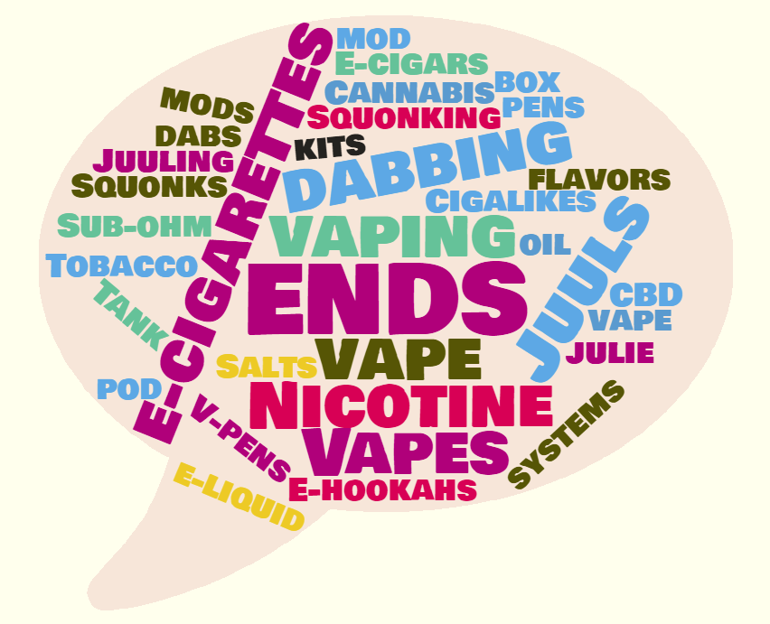
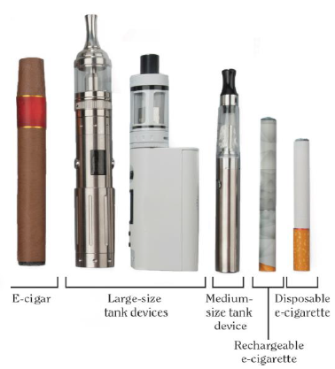
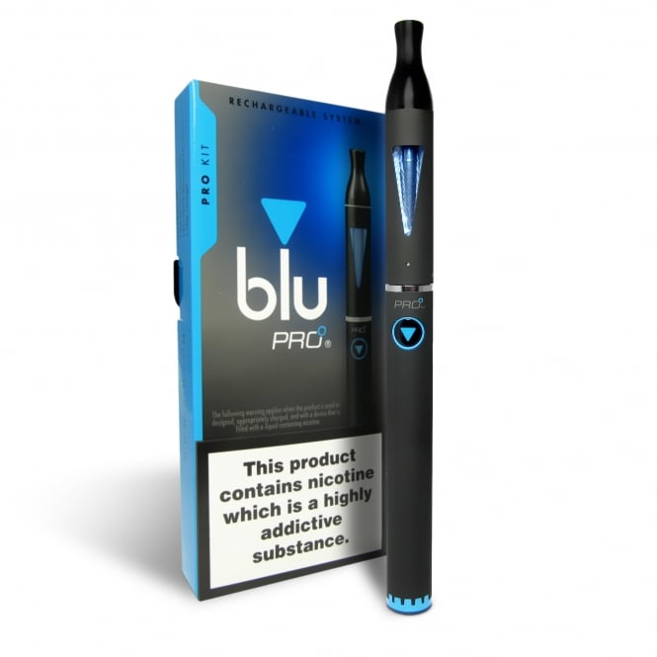
Types of Electronic Nicotine Delivery Systems (ENDS)
Notes:
E-cigarette, or vaping, products can be used to deliver nicotine, cannabis (THC, CBD),
flavorings, chemicals, and other substances.
They are known by many different names and come in many shapes, sizes and device
types. Devices may be referred to as
● E-cigs
● Vapes
● Vape pens
● Tanks
● Mods
● Pod-Mods
● Electronic nicotine delivery systems (ENDS)
A 2 mg Suorin pod contains the equivalent amount of nicotine as three packs of cigarettes

Slide 9
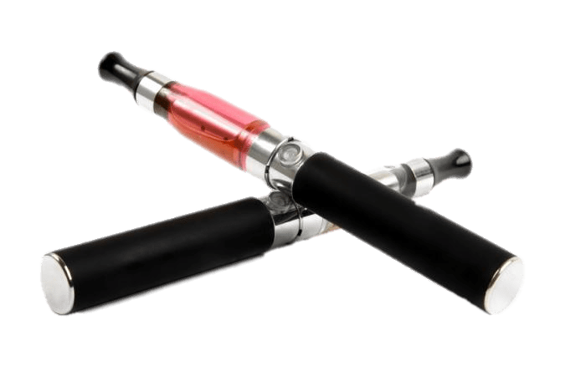
How ENDS Work?
Electronic cigarettes are battery-powered devices that deliver nicotine and/or flavoring to the user in the form of an aerosol (not water vapor).
E-Liquids, when heated, may form additional harmful compounds that are also inhaled by the user.
E-Liquids typically use propylene glycol and/or vegetable glycerin as the solvents for the nicotine and flavoring chemicals
These elements may be safe in food products. However, they have not been tested for safety when used in ENDS and inhaled into the lungs.
Vaping is actually a misnomer.
ENDS create aerosol, not water vapor.
Aerosol is harmful. It contains harmful and potentially harmful chemicals in addition to nicotine.
Notes:
ENDS aerosol is not a water vapor and is not harmless.
It can contain harmful and potentially harmful elements in addition to nicotine.
Carcinogens (formaldehyde, acetaldehyde, acrolein) and toxic heavy metals (lead, cadmium) have been found in ENDS aerosols
Ingredient levels vary, due to the lack of manufacturing standards, ingredient levels vary

Slide 10
What’s in an E-Cigarette/ENDS?
Most ENDS contain nicotine, the addictive drug in other tobacco products.
The amount of nicotine in ENDS varies widely, based on the e-liquid, the temperature of heating, and the depth of the puff
Nicotine salts can be vaped at lower temperatures for a smoother experience, which allows users to consume higher levels of nicotine with less harshness on the throat when compared to traditional vape juices.
ENDS can also be used as a delivery system for alcohol, cannabis and other illicit drugs
Among the 27.3% of students who ever used an e-cigarette device,
1/2 of them reported using their device with a substance other than nicotine, such as cannabis, THC, hash oil, or THC wax.
(2017 CT Youth Tobacco Survey)
Notes:
Data point drives home the point that ENDS can and have been used as delivery systems for substances other than nicotine.

Slide 11
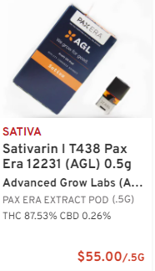
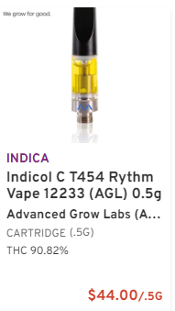
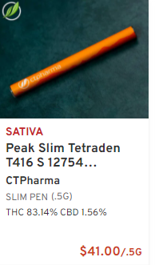
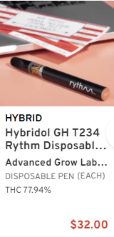
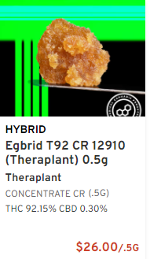
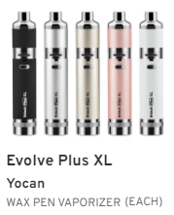
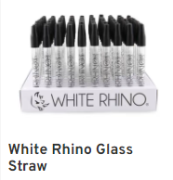
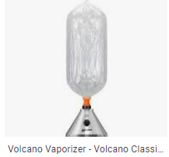
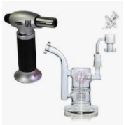
Cannabis Items Related to Vaping
Notes:
Displayed here are a variety of cannabis items related to vaping. Starting at the top left, referred to as a “PAX”, this item mimics the Juul pod and will fit only those systems or “batteries”. Also notice the THC strength in each of these products. This first one being 87.53% pure THC. The second item is a “screw on” style cartridge that is meant to fit a rechargeable battery or “pen”. Very similar to the first item, but specific to a “pen style” system. The next two item are disposal style systems, or systems that do not have a rechargeable battery. The last two items on the top row are examples of other forms of THC that can be vaped. The first is called crumble and the other is called shatter. They get their names because of their consistency which is representative of their extraction/purification methodology. These forms of THC can be vaped in a “pen style” delivery system pictured below, or they can be vaped in the form of a “dab” (see picture below), or they can be vaped in the form of “free basing” using the glass straw pictured below. (The end of the straw is heated with a torch style lighter to produce maximum heat and the hot tip touches the THC product while the user inhales on the opposite end. Lastly pictured is the Volcano style vaporizer. This unit is plugged into an electrical outlet and the vapor is captured inside a plastic bag which the user inhales. Typically this is used to vape cannabis plant or flower instead of concentrates.

Slide 12
Trends in Percent of High School Students Reporting Past 30-Day Use of Electronic Vapor Products vs. Cigarettes: CT 2011-2019
Notes:
Show the data so you can then remind folks that vaping, alcohol and adult use cannabis all require a person to be 21-year old (unless a medical exemption exists)
This graph compares the percentage of high school students reporting 30-day use of Electronic Vapor Products versus combustible cigarettes from 2011-2019.
It clearly shows a surge in electronic vapor products in the last few years since the explosion of e-cigarette options that occurred around 2016.
It also highlights that combustible cigarette use among youth is waning.

Slide 13
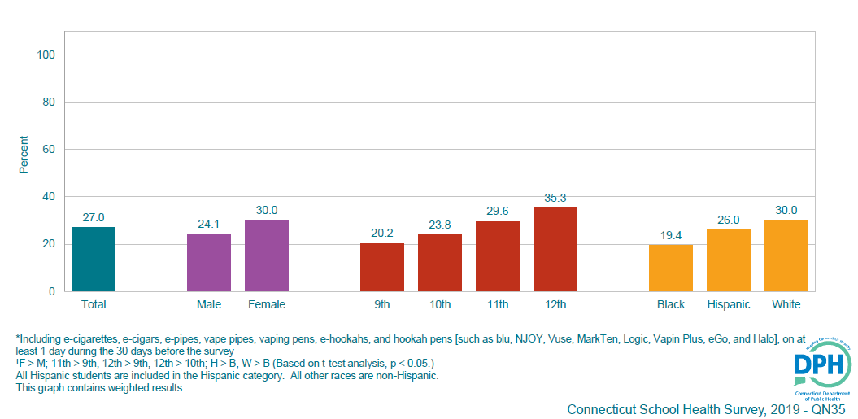
Percentage of CT High School Students who Currently Used an Electronic Vapor Product, by Sex, Grade, Race/Ethnicity, and Sexual Orientation, 2019
Notes:
This graph showcases the disparity in vape usage among subgroups of the student population.
Students more who reported vaping at elevated rates compared to their peers included:
Female Students
Students at later stages in the education (seen in the incremental climb in usage rates as move from 9th to 12th grade students)
White (non-Hispanic) students
Students who identified as Gay, Lesbian, and/or bisexual
Special attention should be paid while implementing and/or developing prevention strategies to ensure that these folks particular/differential experiences are considered and thoughtfully integrated into the framing of prevention practices.

Slide 14
The Health Effects of ENDS on Youth
The nicotine in E-liquids is toxic;
Vaping has caused middle and high school youth to become ill during the school day, reporting nausea, vomiting, and other symptoms;
ENDs are not strongly regulated and much remains unknown about the short and long-term effects of e-cigarette use;
Young people who use e-cigarettes are at risk for long term effects due to exposure to nicotine. These effects include:
Learning and cognitive deficits, memory, attention;
Mood disorders and impulse control;
Increased susceptibility to addictions – nicotine and other substances.
Teens who vape are three and half times more likely to smoke cigarettes³ and almost three (2.7) times more likely to use marijuana.
Did You Know:
Adolescence is a critical time for brain development. Puberty to age 25 is the 2nd highest period of brain growth, after the first five years.
Sources: E-Cigarette Use Among Youth and Young Adults: A Report of the Surgeon General 2016; Berry, et al. 2019; Hongying, et.al, 2019.
Notes:
Now let us review some of the poor health outcomes that have been associated with youth ENDS usage.
The first thing we must recognize is that NICOTINE IS TOXIC
Text on Slide

Slide 15
Section 2: Understanding why kids vape
Why do kids vape?
The Effect of ENDS/E-Cigarette Marketing and Messaging
Vaping Risk Factors
Characteristics that increase likelihood of individual vape use
Notes:
In this section of the we will review why youth are vaping by covering the following;
Youth survey reports on reasons why they vape
The effect of ENDS marketing
Several individual and environmental characteristics that increase a youth’s likelihood of vaping

Slide 16
According to Monitoring the Future 2019:
They want to experiment
They like the flavors
They are addicted to these devices
Easy to conceal
Source: https://www.drugabuse.gov/videos/mtf-2019-why-do-teens-vape-what-are-health-concerns
Why Do Kids Vape?
Studies suggest that kids vape because…
According to the Truth Initiative:
Because a friend or family member used them
The availability of flavors, like mint, candy, fruit or chocolate
The belief that e-cigarettes are less harmful than other forms of tobacco, such as cigarettes
Source: https://truthinitiative.org/research-resources/emerging-tobacco-products/3-main-reasons-youth-use-e-cigarettes
Notes:
So, why do kids vape?
The kids were surveyed, and they reported the following:
According to the 2019 Monitoring the Future Survey kids vape because
They want to experiment
They like the flavors
They are addicted to these devices
The devices are easy to conceal
And according to data from the 2016 National Youth Tobacco Survey, published by the Truth Initiative kids reported vaping because
Because a friend or family member used them
The availability of flavors, like mint, candy, fruit or chocolate
The belief that e-cigarettes are less harmful than other forms of tobacco, such as cigarettes

Slide 17
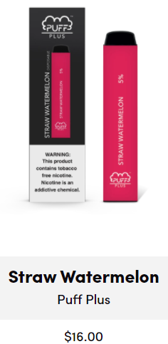
Marketing and Messaging
ENDS manufacturers (including Big Tobacco) are using an old playbook with great success
ENDS products are not yet regulated in the same way as other tobacco products
Lack of regulation over manufacturing standards, ingredients, and sales restrictions have helped to create a billion dollar and growing vaping industry.
A recent study found that Juul stood out from other e-cigarette companies by marketing its devices on social media platforms such as Twitter, YouTube, and Instagram.
That marketing campaign was a big success, the study suggests, with Juul's social-media activities being "highly correlated" with sales.
Notes:
A fundamental reason why ENDS became so popular among youth is because the marketing and associated messaging was targeted directly at them through glitzy eye-catching advertisements on the several of the most popular social media platforms for youth.

Slide 18
Vaping Risk Factors by Environmental Level
Individual Level
Community Level
Low perception of harm - Perceive vaping as safe and less risky than combustible tobacco
Subgroups of youth vape higher rates - Among them are LGBTQ+ youth & white, non-Hispanic youth
Early onset of vape use – the younger a person starts using a substance the more likely they are to misuse the substance
Developing adolescent brain is more vulnerable to addiction
Nicotine changes the structure of brain to increase vulnerability to other substances
Retail access – even with Tobacco 21, some stores sell to underage youth
Social access at school – share, obtain, or purchase from friends
School & workplace policies that do not prohibit vaping as part of tobacco free policies
Regulatory: labeling, pricing, taxes
Society/Cultural Level
Social media vaping marketing targeting youth and young adults. Many using tobacco marketing practices from the past.
Social culture of vaping through online communities
Online accessibility of vapes
Relationship Level
Perception of peer approval
Perception of parent approval
Observing parents use
Social access – obtain vapes from friends and/or parents
Social culture of vaping with peers
Reducing Vaping Among Youth and Young Adults (SAMHSA)
Notes:
Risk Factors are the characteristics (ranging from individual to societal) that increase the likelihood of an individual using substances
Focusing on risk factors associated with vaping here just a few:
Individual Level
Perception of harm. Youth who perceive vaping as safe or less harmful than cigarettes are more likely to vape.
Specific groups of youth and young adults have higher rates of vaping. Data show LGBTQ+ youth and white, non-Hispanic youth vape at higher rates.
Age of first use & adolescent brain. The younger a person starts using a substance increases the risk of misuse and addiction. Also, developing adolescent brains make youth more vulnerable to addiction.
Nicotine changes the structure of brain to increase vulnerability to other substances.
Relationship Level
Perception of peer approval. Youth who think their friends approve of vaping are more likely to vape.
Perception of parent approval. Youth who have parents who express their disapproval are less likely to vape.
Observing parents use. Parents who use increases youth’s perception that vaping is safe.
Social access. Youth who easily get vapes from friends and/or parents increase the possibility of use.
Social culture of vaping with peers. Youth who interact with peers who vape have easy access and may see vaping as less harmful.
Community Level
Retail access. CT Tobacco 21 law applies to the sale of vapes and cigarettes. Stores that illegally sell to underage youth and young adults increase the possibility for youth vaping.
Social access at school. Youth may share, obtain or purchase vapes from other students at school.
Smoke free policies in CT also prohibit vaping. Tobacco policies should target vaping, too.
Regulatory: labeling, pricing, taxes. States have the potential to reduce access through licensing, prices and taxing policies.
Society/Cultural Level
Vaping companies target youth and young adults through advertising on social media . Many using tobacco marketing practices from the past. Adults may not be aware of this advertising directed toward youth.
Youth/young adults create online communities sharing information and demonstrating vaping techniques. Online viewing can contribute to the perception that vaping is harmless and the misperception that more youth are vaping than actually are.
Online purchasing of vapes can increase access and use.

Slide 19
Section 3: How can parents play a role in vape prevention?
Definition of Substance Misuse/Use Prevention
Vaping Protective Factors
Characteristics that decrease likelihood of individual vape use
What can we do to prevent youth from vaping? (Overview)
Prevention Strategies in Communities
Prevention Strategies in Schools
Prevention Strategies for the Home

Slide 20
Substance Misuse/Use Prevention
Prevention is a planned combination of coordinated policies, programs, and practices that target individuals, families, and communities to stop or delay first use of substances and promote mental health.
Notes:
Here we define prevention so that everyone has the same foundational understanding.

Slide 21
Vaping Protective Factors by Environmental Level
Individual Level
Relationship Level
Community/Society/Cultural
High perceived risk of harm
Belief in a moral order
Prosocial involvement
Academic success
High commitment to school
Peer unfavorable attitudes towards substance use
Being perceived as “cool” for prosocial involvement
Interaction with prosocial peers
Family attachment
Prosocial opportunities with family
Prosocial rewards from family
Laws and regulations that limit access and usage of substances
Laws and regulations that restrict marketing to teens
Norms that deem substance use as unfavorable
Source: Burrow-Sánchez, J. J., & Ratcliff, B. R. (2021). Adolescent Risk and Protective Factors for the Use of Electronic Cigarettes. Journal of Prevention and Health Promotion, 2(1), 100–134. https://doi.org/10.1177/2632077020980734
Notes:
There are certain characteristics that decrease the likelihood of individual vape use. These are referred to as “protective factors”.
Offered in this slide are examples of protective factors at each ecological level.

Slide 22
Vaping Prevention: What Can We Do About It?
Parents
Be tobacco free; its never too late to quit
Talk to your kids about why vapes/ENDS are unsafe
Tell your kids that you do not want them to use vapes/ENDS
Set clear rules that discourage vapes/ENDS use
Safely store cannabis in home if you have children
Schools
Administrators:
Policies
It is illegal to sell tobacco or vaping products to anyone under 21.
100% tobacco free school and grounds polices: 24/7/365
Teachers:
Watch for ENDS use and enforce school policies.
Teach the hazards of ENDS use.
Youth prevention education in schools should follow best practice recommendations
Communities
Implement evidence-based prevention strategies that are known to reduce tobacco use, including:
Pricing
Strong smoke-free laws and policies
Social marketing campaigns to increase perception of risk/harm
Enforce the tobacco sale age to 21 that took effect October 1, 2019
Adopting tobacco-free/vape-free policies and promoting tobacco free lifestyles is still a best practice
Notes:
9 out of 10 adult smokers begin by age 18. The less youth see smoking/vaping, the less likely they are to use. Parents play a critical role in the solution … at home, at school, and in the community.

Slide 23
Prevention Strategies in Communities
Implement evidence-based prevention strategies that are known to reduce tobacco use, including:
Strong smoke-free laws and policies
Social marketing campaigns to increase perception of risk/harm
Enforce the tobacco sale age to 21 that took effect October 1, 2019
Restrict point of purchase/promotion
Hold community Health Fairs and/or community forums to provide information about ENDS and to promote cessation resources
Adopting tobacco-free/vape-free policies and promoting tobacco free lifestyles is still a best practice
Action Steps for Parents
Review public policies/ordinances around vaping in your community
Report merchants selling to underage youth to the CT Tobacco Prevention & Enforcement Program to be added to their list of compliance checks
Advocate for tobacco/ENDS merchant training to increase compliance with sales laws
Connect with your local prevention council/coalition
Prevention Resources available
CT Department of Public Health Tobacco Control and Prevention Program
CT Department of Mental Health & Addiction Services (DMHAS) - Vaping Resources Information and Resources CT Tobacco Prevention & Enforcement Program
CT Regional Behavior Health Action Organizations
CT Clearinghouse ctclearinghouse.org

Slide 24
Prevention Strategies in Schools
For Administrators:
Institute an Evidence-Based Prevention Education Curriculum
Policy
Alternative to suspensions for school policy violations (see resources section)
It is illegal to sell tobacco or vaping products to anyone under 21
100% tobacco free school and grounds polices: 24/7/365
For Teachers:
Watch for ENDS use and enforce school policies
Teach the hazards of ENDS use.
Youth prevention education in schools should follow best practice recommendations
Reducing Vaping Among Youth and Young Adults – Strategy Guide | Substance Abuse and Mental Health Services Administration
Action Steps for Parents
Research the health/drug prevention programming and policy at your child’s school:
Ask your child’s teachers and/or school admin:
Whether they offer a prevention education curriculum?
Does their prevention education curriculum cover e-cigarettes and their dangers?
Is vaping included in the school’s smoke free policy?
Does policy offer restorative practices to help youth learn about vaping consequences of quit
Prevention Education Curricula to review and advocate for implementation:
The Real Cost of Vaping
Know the Risks: A Youth Guide to E-Cigarettes
Stanford Medicine – Tobacco Prevention Toolkit
CATCH My Breath

Slide 25
Prevention Strategies for the Home
Model healthy behaviors; its never its never to late to quit using tobacco
COMMIT TO QUIT CT
Smoke Free
Talk to your kids about why vapes/ENDS are unsafe
Tell your kids that you do not want them to use vapes/ENDS
Set clear rules that discourage vapes/ENDS use
Safely store vapes/cannabis in home if you have children
Role play resistance strategies (Discuss exit plans with your children)
Action Steps for Parents
Establish a vape/substance free household necessary, store vapes in a secure location.
Ask local resource providers if they offer vaping education and cessation programs:
Pediatrician
Family doctor
Health Clinic
Know the facts! Before starting a conversation with your child review vaping health risks and any associated data.
If your child has started vaping talk to them about why they are using
In the next section we will outline some tips on how to start a conversation about vaping risks with your child
Notes:
Establish a vape/substance free household
necessary, store vapes in a secure location
Ask local resource providers if they offer vaping education and cessation programs:
Pediatrician
Family doctor
Health Clinic
Know the facts! Before starting a conversation with your child review vaping health risks and any associated data.
If your child has started vaping talk to them about why they are using
In the next section we will outline some tips on how to start a conversation about vaping risks with your child

Slide 26
Section 4: Parent/Guardian and Child Communication Tips by Age Group
Preschool (2-4 Years)
Early Elementary (5-8 Years)
Preteens (9-12 Years)
Teens (13-18 Years)
Young Adult (19-24 Years)

Slide 27
Family Communication For Each Age Group
Tips for Conversations with a Child of Any Age
Always keep conversations open and honest
Come from a place of love, even when you’re having tough conversations
Balance positive reinforcement with negative consequences
Keep in mind that teachable moments come up all the time, be mindful of natural places for the conversation to go in order to broach the topic of drugs and alcohol
A conversation with is one of the most powerful tools a parent can use to protect their kids from the dangers of drug and alcohol misuse.
Although powerful, talking to youth about drugs and alcohol can be very challenging.
The following slides provide some tips that can help you start a conversation with your child depending on their age group:
Preschool (2-4 Years)
Early Elementary (5-8 years)
Preteens (9-12 years)
Teens (13-18 years)
Young Adult (19-24 years)

Slide 28
Preschool (2-4 Years)
Early Elementary (5-8 Years)
Since the foundation for all healthy habits – from nutrition to toothbrushing – is laid out during the preschool years, this is a great time to set the stage for a drug-free life.
Explain the importance of taking good care of our bodies
Celebrate your child’s decision-making skills
Help your child steer clear dangerous substances that exist in their immediate world
Turn frustration into a learning opportunity
Children in this age group are still tied to family and eager to please, but they’re also beginning to explore their individuality.
Talk to your kids about the drug related messages they receive
Keep your discussions about substances on the present
Set clear rules and explain the reasons for your rules
Work on problem solving by helping them find long-lasting solutions
Give your kids the power to escape from situations that make them feel bad

Slide 29
Preteens (9-12 Years)
Preteens on their quest to figure out their place in the world, tend to give their friends’ opinions a great deal of power. At the same time, they are starting to question their parents’ views and messages.
Make sure your child knows your rules – and that you’ll enforce the consequences if rules are broken
Kids who don’t know what to say when someone offers them drugs are more likely to give into peer pressure. Let your kids know that they can always use you as an excuse.
Feelings of insecurity, doubt, and pressure may creep in during puberty. Offset those feelings with a lot of positive comments about their personal strengths and who they are becoming as individuals.
Get to know your child’s friends – and their friends’ parents.

Slide 30
Teens (13-18 Years)
This is a pivotal time for parents in helping kids make positive choices when faced with drugs and alcohol. Teens are a savvy bunch when it come to this topic, and the need details and reality- driven messages from parents.
Make sure your teen knows your rules and the consequences for breaking those rules – and, most importantly, that you really will enforce those consequences if the rules are broken.
Make it clear that you disapprove of all alcohol, tobacco, and drug use
Share with our teen all the things you find wonderful about them.
Show interest in and discuss your child’s daily ups and downs.
Don’t just leave your child’s drug education up to school.
Be sure you explain the danger in mixing drugs, such as opioids with alcohol.
Help your teen create and EXIT PLAN in case he or she is offered or faced with a difficult decision about substances use.
Exit Plan
Practice ways of saying NO firmly
Leave the situation
Create a code word if your teen calls you and would like to be picked up
Praise when your teen takes steps to leave a situation and communicates with you on the reasons, fostering trust

Slide 31
Young Adults (19-24 Years)
Whether your young adults is heading to college, the military, or into the workforce, they are taking their first steps towards greater independence. As decisions are discussed it remains just as important to keep talking with them about substance use and the possible consequences to their well-being.
Keep in touch and talk overall about their choices and decisions.
Point out the resources available to them wherever they are headed, who to contact for help from counseling staff or advisors, specific extra curricular groups and housing choices.
Point out the dangers of substances today being more concentrated, the dangers of mixing substances, and how substances’ concentration can be obscured
Discuss how to handle situations where substances may arise in their new environments.
Ensure they are aware of the employee benefits or programs and polices if going into the workplace.
If headed to college, make sure they know the school’s policies and resources on campus.
If headed to the military, Military One Source provides family resources in prevention, treatment and counseling.
If your child is injured or needs surgery, ensure they know what questions to ask around pain management options.
Know that your young adults still needs guidance, support and understanding as they make this transition and to be comfortable broaching these subjects with them on a regular basis.

Slide 32
Section 5: Resources
Resources by Environmental Level
Home | Schools | Communities
General Vaping Prevention
Vaping & Tobacco Cessation Programs
State Prevention Resources

Slide 33
Resources by Environmental Level
Parents
Schools
Communities
Know the Risks - E-Cigarettes & Young People
CATCH My Breath - Parent Resources
FDA Tobacco Products Information
CDC E-Cigarettes
Youth Activities by Scholastic
How to talk to your kids about vaping? - American Lung Association
Cruise Into Communications Videos on Next Slide
Truth Initiative – Youth Vaping Curriculum
Stanford Tobacco Prevention Toolkit, Curriculum
CATCH My Breath, Prevention Curriculum
Alternative to Suspension Programs
ASPIRE: A Smoking Prevention Interactive Experience
Stanford Tobacco Prevention Toolkit’s Alternative to Suspension Program
American Lung Association – Alternative to Suspension
Disposing of E-Cigarette Waste | Public Health Law Center
American Lung Association – Vape-Free Schools Initiative
Policy Playbook for E-Cigarettes - Public Health Law Center
Guided Video Presentation
Licensing Laws and Policies
Use Restrictions
Pricing Policies
E-Cigarette – Excise Tax Options
Tobacco & E-Cig Point of Sale – Regulating Retailers for Public Health
States & Municipalities with Laws Regulating Use of E-Cigarettes | American Nonsmokers’ Rights Foundation
Increasing Tobacco Prices through Non-Tax Approaches

Slide 34
Vaping Resources
Cruise into Communication Messages
Cannabis Prevention
Tips on having prevention conversations with:
Teens | Young Adults | Pre-Teens
TTASC Cannabis – Changing the Conversation Between Youth & Adults
EmpoweringParents – How to Talk to Your Child About Cannabis: 4 Responses for Parents
How Cannabis Legalization Could Change The Way Parents Talk to Their Kids About Pot
New England Prevention Technology Transfer Center | Summary of Cannabis Law
Connecticut Vaping Resource Committee
The Vaping Resources Committee’s goal is to gather, consolidate, and where necessary, create fact-based effective resources for consistent use across the state to address the vaping crisis in Connecticut:
Resource Webpage
TTASC What You Should Know About Vaping Video
TTASC Prevention 101 Training Presentation
Prevention Program
INDEPTH – The Intervention for Nicotine Dependence: Education, Prevention, Tobacco and Health is a facilitated four-session program.
Not On Tobacco – Is a voluntary 10-session cognitive-behavioral change program that encourages voluntary change for youth.

Slide 35
Cessation Resources
Commit to Quit
Truth Initiative
SmokeFree
Become an EX
DPH sponsors a statewide tobacco use cessation telephone quitline: 1-800-QUIT-NOW or via COMMITTOQUITCT.COM
Prevention messages are aired across television and digital platforms targeted to youth and young adults, ages 15-24. The messages describe the harms associated with smoking and nicotine vaping.
US Department of Health and Human Services website with customized FREE online resources for when teens, veterans, seniors, and Spanish language resources.
Online software that allows you to create a customized quitting plan that grows and learns as with you.

Slide 36
Connecticut Resources
CT Department of Mental Health & Addiction Services (DMHAS)
Vaping Resources Information and Resources
CT Tobacco Prevention & Enforcement Program
CT Department of Public Health
Tobacco Control and Prevention Program
CT Clearinghouse
Phone: 1-800-232-4424
Website: ctclearinghouse.org
CT Regional Behavior Health Action Organizations
CT Prevention Training & Technical Assistance Service Center

