Slide 1
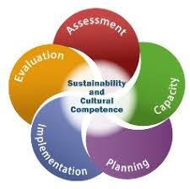
Strategic Prevention Framework 101
Preventiontrainingcenter.org

Slide 2
Overview
Strategic Prevention Framework (SPF) is a dynamic, data-driven planning process that prevention practitioners can use to understand and more effectively address the substance abuse and related mental health problems facing their communities.
LEARNING OBJECTIVES
Explain the purpose of the Strategic Prevention Framework
Describe the steps and guiding principles of the SPF
Define the purpose and key concepts associated with each step of the SPF
Identify ways to demonstrate cultural competence during each step of the SPF
Identify ways to promote sustainability during each step of the SPF
Access additional resources to enhance your understanding and application of the SPF

Slide 3
A dynamic and iterative process: assessment is the starting point, but practitioners will return to this step again and again as their community’s prevention needs and capacity evolve. Communities may also engage in activities related to multiple steps simultaneously. For example, practitioners may need to find and mobilize additional capacity to support implementation once an intervention is underway. For these reasons, the SPF is a circular—rather than a linear—model.
A data-driven model: The SPF is designed to help practitioners gather and use data to guide all prevention decisions—from identifying which substance use problems to address in their communities, to choosing the most appropriate ways to address these problems, to determining whether communities are making progress in meeting their prevention needs.
A team approach: Each step of the SPF requires the participation of diverse community partners. Multiple partners bring different expertise and perspectives to the team. The individuals and institutions may change as the initiative over time, but the need for prevention partners will remain.
Defining Features
Key Characteristics of the SPF

Slide 4
Strategic Prevention Framework (SPF)
The five steps and two guiding principles of the SPF offer prevention planners a comprehensive approach to understanding and addressing the substance misuse and related behavioral health problems facing their states and communities.
The SPF includes these five steps:
1 . Assessment: Identify local prevention needs based on data. What is the problem?
2 . Capacity: Build local resources and readiness to address prevention needs. What do you have to work with? Is our community ready to address the identified problem?
3 . Planning: Find out what works, evidenced based strategies, to address prevention needs and how to do it well What should you do and how should you do it?
4 . Implementation: Deliver best fit evidence-based programs and practices as intended. How can you put your plan into action?
5 . Evaluation: Examine the process and outcomes of programs and practices (Is your plan succeeding?)
The SPF is also guided by two cross-cutting principles that should be integrated into each of the steps:
Cultural Competence. The ability of an individual or organization to understand and interact effectively with people who have different values, lifestyles, and traditions based on their distinctive heritage and social relationships.
Sustainability. The process of building an adaptive and effective system that achieves and maintains desired long-term results
2
1/12/21
Notes:
Click on the Title to be taken to SAMSHA SPF Guide

Slide 5
Prevention Framework
Assessment
Define and Describe the Community
Collect Comprehensive Data
Identify Priority Substance(s) and Population(s)
4. Create Logic Model
Evaluation
Assess short term and long-term changes to your goals
Document and Present Successes and Challenges
Use Evaluation Data to Guide Programming
Use both Qualitative and Quantitative Methods of Evaluation
Build Coalition Capacity
Build Coalition Membership
Develop Coalition Structure
Cultivate Coalition
Identify Resources and Readiness
Implementation
Prioritize Strategies and Action Plan Timeliness
Utilize Coalition Resources to Deliver Programming
Ensure Implementation Fidelity
Share Messaging with Sectors Partners and the Community
Planning
Create a Vision and Mission
Identify Objectives to Meet Local Needs
Plan Strategies and Activities
Develop Action Plans for each strategy
Sustainability
Create Sustainability Plan
Engage Stakeholders
Best Fit Strategies
Human and Fiscal Resources
Cultural Competence
Identify Subgroup Populations
Address Disparities
Ensure broad community representation
Evaluate Impact

Slide 6
Step 1: Assessment
Assessment involves identifying local prevention needs based on data.
To conduct a comprehensive assessment of prevention needs, you will gather data about:
Substance abuse problems and related behaviors.
Risk and protective factors for priority substances and populations.
Capacity, including resources and readiness to address identified problems.
Sources of the data will vary based on each community but may include information from each of the 12 Sectors: School, Law Enforcement, Hospital/Health, Youth, Community/Population Demographics, Parents, etc.
Once you have completed this assessment, it is important to share key findings with diverse prevention stakeholders.

Slide 7
Assessment
Questions to guide your community assessment of substance use problems and related behaviors:
What substance use issues and related behaviors are occurring in your community?
Where are these substance use issues and related behaviors occurring?
Who is experiencing these substance use problems and related behaviors?
This information can help you identify and determine how to most effectively address your community’s priority substance use problem(s) and priority population(s).

Slide 8
Cultural Competence and Sustainability in Assessment
The following assessment activities are examples of culturally competent prevention practices and ways to make sure that your assessment data reflect the diversity of your community:
Gather existing data about different population groups in your community, including those considered hidden or hard-to-reach.
Collect new data to fill a gap in your understanding of problems and behaviors within a specific population group .
Share your assessment findings with and solicit input from individuals and groups throughout your community—including focus population members, prevention partners, and local leaders.
Even though assessment marks the beginning of the prevention planning process, many assessment activities support the long-term sustainability of prevention efforts, for example:
• Basing prevention-related decisions on high-quality state and local data
• Assessing resources needed for prevention and considering how to fill gaps
• Assessing readiness for prevention and considering how to bring community leaders along

Slide 9
Step 2: Capacity
Capacity involves building and mobilizing local resources and readiness to address identified prevention needs.
Resources: A community needs both human resources and structural resources to establish and maintain a prevention system that can respond effectively to local problems.
Readiness describes the motivation and willingness of a community to commit local resources to address identified prevention needs. Prevention programs, policies, and strategies are always more likely to be successful and sustained if they are well supported.
The following are some strategies for building local capacity for prevention:
1. Engage diverse community stakeholders
2. Develop and strengthen a prevention team or coalition
3. Raise community awareness of the issue to increase readiness
4. Identify resources to support the coalitions activities

Slide 10
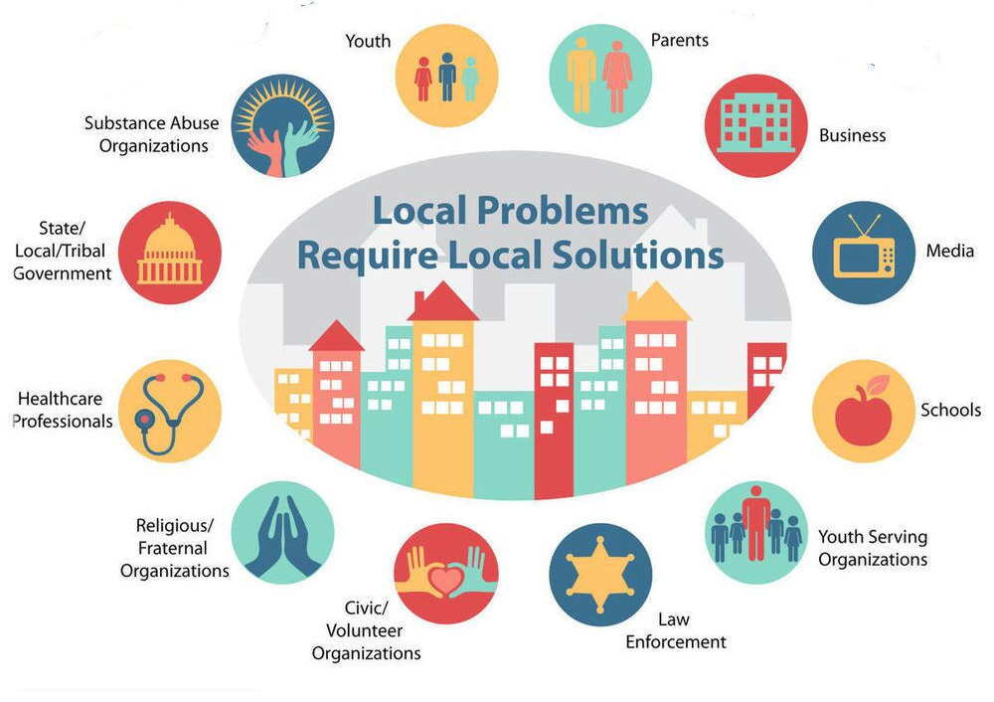
Capacity
The following are the 12 different community sectors to involve in your prevention initiative:
CADCA National Coalition Institute: Drug Free Communities

Slide 11
Cultural Competence and Sustainability in Capacity
Below are some examples of capacity-building activities that will help to ensure that your prevention efforts will be culturally competent:
• Recruit prevention partners from diverse community sectors
• Connect with high-risk and hard-to-reach populations, and recruit representatives from these groups to join your coalition
• Help your coalition learn about your focus population
• Help your coalition learn about diversity and cultural competence
Many capacity-building activities support the long-term sustainability of prevention efforts, for example:
• Engaging partners and tapping resources from diverse community sectors
• Build widespread community awareness of the problem(s) and support for prevention
• Cultivating champions among influential leaders and decision makers
• Building task force capacity to support evidence-based prevention and recruit implementation partners
By building and mobilizing local capacity for prevention, you create the foundation your community will need to begin developing prevention efforts that will be effective and enduring.

Slide 12
Step 3: Planning
Planning involves how to best address identified prevention needs and associated factors.
To develop a solid prevention plan:
• Prioritize risk and protective factors identified for your community
• Select appropriate interventions to address each priority factor
• Combine interventions to ensure a comprehensive approach. Interventions should reinforce each other. Interventions can target more than one risk or protective factor.
• Build and share a logic model with stakeholders

Slide 13
Planning: Risk and Protective Factors
To prioritize factors, it’s helpful to consider a factor’s importance and changeability.
Importance describes how a specific risk or protective factor affects a problem.
To determine a factor’s importance, ask yourself the following questions:
How much does this factor contribute to our priority problem?
Is this factor relevant, given the developmental stage of our focus population?
Is this factor associated with other behavioral health issues?
Changeability describes a community’s capacity to influence a specific risk or protective factor..
To determine a factor’s changeability, ask yourself the following:
Do we have the resources and readiness to address this factor?
Does a suitable intervention exist to address this factor?
Can we produce outcomes within a reasonable timeframe?.
When developing a prevention plan, it is best to prioritize risk and protective factors that are high for both importance.

Slide 14
Planning
Prioritizing Risk and Protective Factors:
Identify which risk and protective factors to address first.
To prioritize factors, it’s helpful to consider a factor’s importance and changeability.
• Importance describes how a specific risk or protective factor affects a problem. To determine a factor’s importance, ask yourself the following questions: How much does this factor contribute to our priority problem?
Is this factor relevant, given the developmental stage of our focus population?
Is this factor associated with other behavioral health issues?
• Changeability. This describes a community’s capacity to influence a specific risk or protective factor. To determine a factor’s changeability, ask yourself the following:
Do we have the resources and readiness to address this factor?
Does a suitable intervention exist to address this factor?
Can we produce outcomes within a reasonable timeframe?
When developing a prevention plan, it is best to prioritize risk and protective factors that are high for both importance and changeability.

Slide 15
Planning: Selecting Appropriate Strategies
Identify the prevention strategies and activities that can effectively address the priority substance use problem and associated risk and protective factors, and that are a good fit for the broader community.
The following are three important criteria for selecting appropriate prevention strategies and activities:
• Evidence-based: Interventions that have documented evidence of effectiveness. Since states have different guidelines for what constitutes credible evidence of effectiveness, you could start by talking to prevention experts— including your state-level evidence-based workgroup.
• Conceptual fit: An intervention has good conceptual fit if it directly addresses one or more of the priority factors driving a specific substance use problem and has been shown to produce positive outcomes for members of the focus population. To determine the conceptual fit of an intervention, ask yourself, “Will this intervention have an impact on at least one of our community’s priority risk and protective factors?
• Practical fit: An intervention has good practical fit if it is culturally relevant for the focus population, a community has the capacity to support it, and it enhances or reinforces existing prevention activities. To determine the practical fit of an intervention, ask yourself, “Is this intervention appropriate for our community?”
Evidence-based interventions with both conceptual fit and practical fit will have the highest likelihood of producing positive prevention outcomes.

Slide 16
Planning
Selecting Appropriate Strategies
Identify the prevention strategies and activities that can effectively address the priority substance use problem and associated risk and protective factors, and that are a good fit for the broader community.
The following are three important criteria for selecting appropriate prevention strategies and activities:
• Evidence-based: Interventions that have documented evidence of effectiveness. Since states have different guidelines for what constitutes credible evidence of effectiveness, you could start by talking to prevention experts— including your state-level evidence-based workgroup.
• Conceptual fit: An intervention has good conceptual fit if it directly addresses one or more of the priority factors driving a specific substance use problem and has been shown to produce positive outcomes for members of the focus population. To determine the conceptual fit of an intervention, ask yourself, “Will this intervention have an impact on at least one of our community’s priority risk and protective factors?
• Practical fit: An intervention has good practical fit if it is culturally relevant for the focus population, a community has the capacity to support it, and it enhances or reinforces existing prevention activities. To determine the practical fit of an intervention, ask yourself, “Is this intervention appropriate for our community?”
Evidence-based interventions with both conceptual fit and practical fit will have the highest likelihood of producing positive prevention outcomes

Slide 17
Building a Logic Model
A logic model is a graphic planning tool, much like a roadmap, that can help your team communicate where you want to go and how you intend to get there. A logic model includes the following components:
When developing a logic model, it’s important to work with an evaluator to identify a set of anticipated outcomes that are clear and measurable.
Outcomes are the changes communities want their interventions to produce.
Prevention outcomes fall into two categories: Short Term and Long Term
Substance Problem and Related Behavioral Health
Associated Risk and Protective Factors
Strategies, Activities, and Interventions
Outcomes
Short-term outcomes are the most immediate effects of an intervention. They have the following traits:
Are closely related to how well the intervention is implemented
Usually include changes in knowledge, attitudes, beliefs, and skills
Tend to be connected to changes in priority risk and protective factors
Long-term outcomes are the ultimate effects of interventions after they have been in place for a while. They exhibit these traits:
Usually result from positive short-term outcomes that can, over time, lead to long-term behavioral changes and associated problems or consequences
May take a long time to produce and measure—sometimes many years

Slide 18
Cultural Competence & Sustainability in Planning
Planning activities can help ensure that your prevention efforts will be culturally competent:
• Use assessment data from diverse community groups to make planning decisions
• Include focus population members as active participants and decision makers in the planning process
• Incorporate prevention interventions that are appropriate for and specific to high-risk and cultural groups
Many planning activities help support the long-term sustainability of prevention efforts.
Examples include:
• Use prevention data to determine which risk and protective factors to address in order to have the biggest impact in the community
• Identify evidence-based interventions that directly address priority factors
• Select those interventions that a community has sufficient capacity to implement effectively
• Make the planning process transparent and inclusive by sharing information with and inviting participation from key stakeholders

Slide 19
Step 4: Implementation
Implementation involves putting your plan into action by delivering evidence-based interventions as intended.
Implementation Partners: You will have already identified and connected with key implementation partners, sectors and stakeholders during the previous steps of the SPF. These are the individuals and organizations that will be responsible for and involved in the delivery of your selected interventions, activities and strategies.
Fidelity and Adaptation
As you prepare to implement your selected prevention interventions, it is important to fidelity and adaptation with your implementation partners
Fidelity: Describes the degree to which a program or practice is implemented as intended. Evidence-based programs are defined as such because they consistently achieve positive outcomes. The greater your fidelity to the original program design, the more likely you are to reproduce those positive results
Adaptation: Describes how much, and in what ways, a program or practice is changed to meet local circumstances.

Slide 20
Cultural Competence & Sustainability in Implementation
The following implementation activities can help to ensure that your prevention efforts will be culturally competent:
• Identify interventions with documented effectiveness for your focus population
• Involve focus population members, including potential intervention participants and cultural leaders, in the process
• Identify stakeholders and partners to implement interventions who is a good and comfortable fit for the focus population
Many implementation activities help support the long-term sustainability of prevention efforts. Examples include the following:
• Ensure that interventions are evidence-based and part of a comprehensive prevention plan
• Increase the cultural relevance of interventions without compromising their effectiveness
• Work closely with implementation partners to build capacity for prevention and evaluation
• Reach out to implementation and other community sector partners to increase support for prevention
Celebrate the small wins that occur from implementation and note progress.

Slide 21
Step 5: Evaluation
Evaluation involves examining both the process and outcomes of prevention interventions.
Evaluation is the systematic collection and analysis of information about prevention activities to assess goal achievement, improve effectiveness, and make decisions on adaptations.
Process evaluation, documents the implementation of an intervention, can be used to improve intervention delivery and make mid-course corrections, and enhance understanding of prevention outcomes.
Outcome evaluation, measures the effects of an intervention following its implementation, can reveal whether the intervention produced the anticipated short- and long-term prevention outcomes and helped build support for those interventions that worked.

Slide 22
Evaluation Types
There are two main types of evaluation: Process and Outcome.
Process evaluation, documents the implementation of an intervention, can be used to improve intervention delivery and make mid-course corrections, and enhance understanding of prevention outcomes.
The following are examples of process evaluation questions:
To what extent were program sessions delivered as original designed?
How many people participated in the program?
How many participants did not complete the program?
Outcome evaluation, measures the effects of an intervention following its implementation, can reveal whether the intervention produced the anticipated short- and long-term prevention outcomes and helped build support for those interventions that worked. The following are examples of outcome evaluation questions:
To what extent did priority population attitudes, knowledge or skills toward the priority substance change?
To what extent did local rates of substance use behavior specific to the priority problem(s) change?

Slide 23
Evaluation and Communicating Findings
The following are some different reasons and ways to communicate evaluation findings:
Discuss evaluation results with coalition members to demonstrate progress, improve programs, celebrate success, and serve as spokespersons
Submit a short press release to local newspapers
Provide multiple community presentations and/or convene a town hall meeting
Create fact sheets and/or infographics of key findings to post on websites, distribute to email lists and to share on social media
Create a full evaluation report to share with funders or potential funders
Explore findings and potential next steps with local cultural and advocacy groups

Slide 24
Cultural Competence & Sustainability in Evaluation
Evaluation methods can be used to identify if strategies and activities are having the intended effect on the target population(s) and disparities.
Schedule follow up meetings with priority population groups, coalition members and community partners to share and discuss evaluation findings.
Use evaluation results to guide future programming, set goals, secure funding, and to allocate resources.

Slide 25
Quiz:
Polls Used to quiz SPF Steps knowledge

Slide 26
SPF Action Planning Tool
Break down five SPF steps into tasks
Record progress and challenges
Provide due date and status
Share with coalition and partners

Slide 27
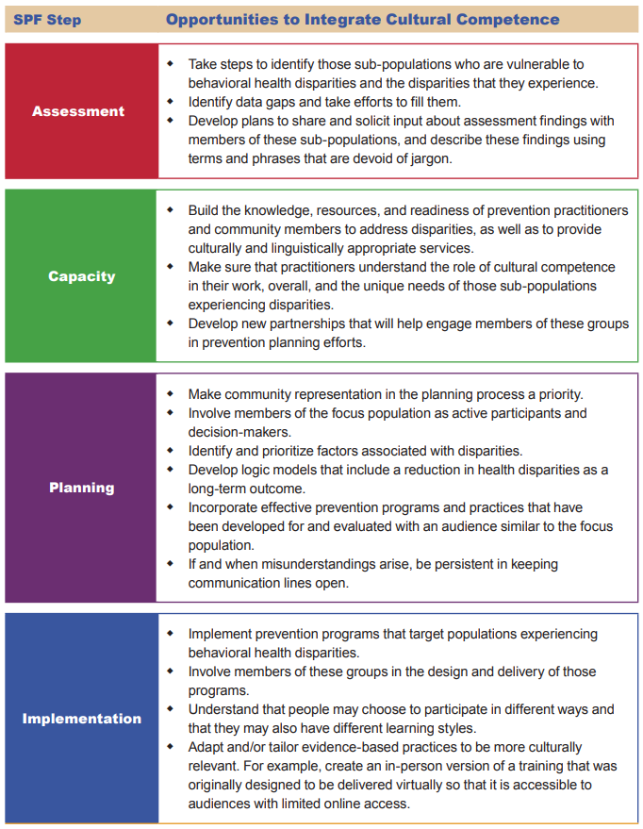
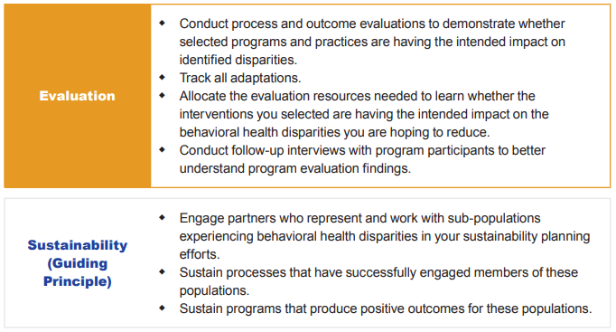
Appendix C
Opportunities to Integrate Cultural Competence across Steps of the Strategic Prevention Framework
A Guide to SAMHSA’s Strategic Prevention Framework. 2019
20
1/12/2021

Slide 28
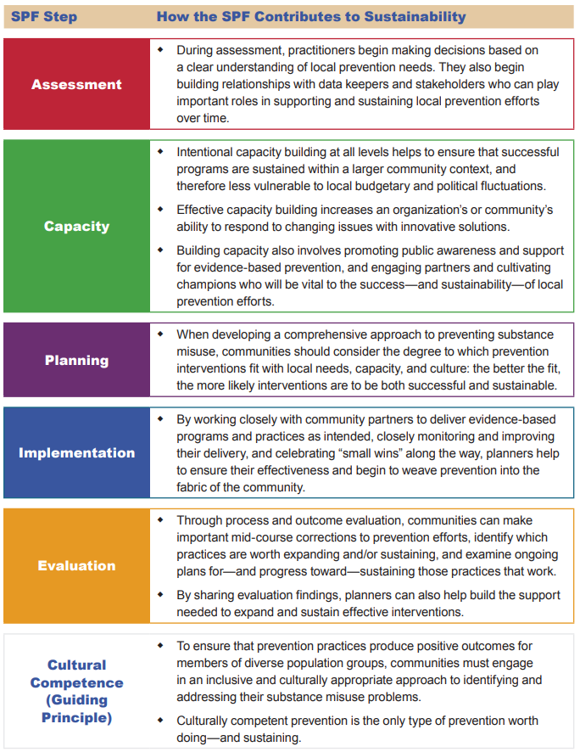
Appendix D
How the SPF Contributes to Sustainability
A Guide to SAMHSA’s Strategic Prevention Framework. 2019
21
11/12/2021

Slide 29
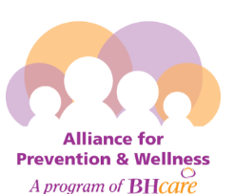
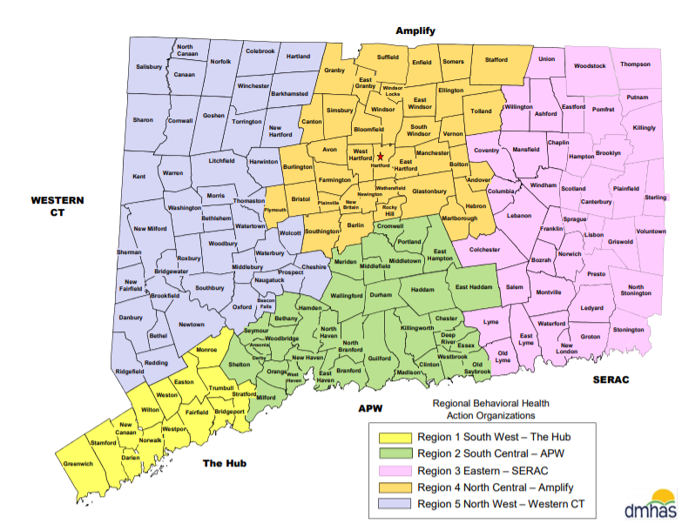
Regional Behavioral Health Action Organizations
https://www.thehubct.org/
https://www.apw-ct.org/
https://www.seracct.org/
https://amplifyct.org/
https://www.wctcoalition.org/

Slide 30
Resources and Citations
A Guide to SAMHSA’s Strategic Prevention Framework
https://www.samhsa.gov/sites/default/files/20190620-samhsa-strategic-prevention-framework-guide.pdf
SPF Coalition Customizable Action Template
CADCA National Coalition Institute
TTASC Website: preventiontrainingcenter.org
Lisa Mason: mason@xsector.com
Jennifer Jacobsen: jacobsen@xsector.com

Slide 31
Glossary
Adaptation: describes how much and in which ways a prevention intervention is changed to meet local needs.
Assessment: the first SPF step uses data to identify local prevention needs, resources and readiness.
Best-Fit prevention strategies: prevention strategies that have both conceptual fit, evidence they addresses priority substance(s) and associated risk factors, and practical-fit, are culturally relevant for the focus population, and the community has the capacity to support it.
Capacity Building: the second SPF step builds and mobilizes local resources and community readiness to address identified prevention needs and sustain prevention interventions.
Cultural Competency: the ability to understand and interact effectively with people who have different values, lifestyles and traditions based on distinctive heritage and social relationships.
Evaluation: the fifth SPF step assesses the effectiveness of prevention interventions by collecting process and outcome data. Process evaluation documents the implementation of prevention strategies. Outcome evaluation measures the effectiveness of the prevention strategies.
Evidence-based prevention strategies: prevention strategies that have documented research demonstrating they address specific substances and associated risk factors.
Fidelity: describes the degree to which the prevention intervention is implemented according to its design. The greater the fidelity, the more likely the intended effects will be achieved.
Implementation: the fourth SPF step puts the strategic plan into action by delivering best-fit prevention strategies and recruiting coalition members and partners to collaborate on implementation.
Logic Model: a graphic representation or roadmap that shows the relationship among the priority substance(s), prioritized risk factors, best fit prevention strategies, and desired outcomes. Logic models provide the rationale for prevention activities.
Outcomes: the effects of the prevention strategies that are implemented. Short-term outcomes are the most immediate effects including implementation data and changes in risk factors such as knowledge, attitudes and skills. Long-term outcomes are ultimate effects of the prevention interventions such as usage rates. Long-term outcomes can take a long time to produce and measure.
Planning: the third SPF step selects best-fit prevention strategies to address the priority substance(s) and associated risk factors and the outcomes expected from these prevention interventions.
From A Guide to SAMHSA’s Strategic Prevention Framework

Slide 32
Glossary
Protective Factors: Variables that decrease the probability an individual may use substance(s) and develop substance misuse problems. Protective factors are associated with the family, school, peer, neighborhood and community domains and can be enhanced with prevention strategies.
Priority Population: the population group identified as most impacted by the substances in the needs assessment.
Priority Substance(s): the substance(s), alcohol or other drugs, identified by the needs assessment as impacting the community and with potential for change through prevention interventions.
Readiness: the community’s willingness and capacity to identify and address local prevention needs. Building readiness is important to gain short-term and long-term community support for prevention activities.
Resources: human, financial, material and structural resources needed to establish and maintain a prevention system than can respond to local problems.
Risk Factors: variables that increase the probability of using substances and developing a substance misuse problem. Risk factors are associated with the family, school, peer, neighborhood and community domains and can be reduced with prevention strategies.
Strategic Prevention Framework: the five step public health planning process using data to identify and address local prevention needs.
Sustainability: the process of building an adaptive and effective system that achieves and maintains desired long-term results.
12 Sectors: the 12 different community groups recommended for coalition membership and partners including youth, parents, youth serving organizations, schools, law enforcement, healthcare, substance abuse organizations, religious/fraternal organizations, civic/volunteer organizations, state/local/tribal government, business and media.
From A Guide to SAMHSA’s Strategic Prevention Framework

Slide 33
Training Needs Assessment Polls
3 quick questions regarding
Training methods
Training topics
Prevention tools

